Slide 1
How to play
Explain that you will show the children things they have at home, and they need to decide if they think it is “safe to play” with or they should “stay away”.
Safe to play – children put their thumbs up, smiling face and say “safe
to play”.
Stay away – children put their thumbs down, sad face and say “stay away”.
Ask a child to choose a numbered box.
Click on a box to show an image of something they have at home.
Ask the children if they think it is safe to play or stay away?
Click on the item to reveal the answer.
In the notes box and on the crib sheet there are safety messages you can share.
Click the slide again to go back to the main choices screen.
When you have finished, click on the DWISE logo.
This will take you to the final slide to remind them the items which are “safe to play” with and anything that is HOT, they should “stay away” from.

Slide 3
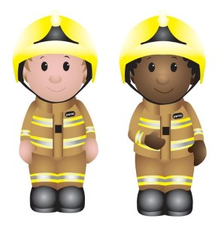
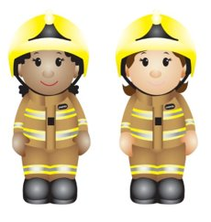
Fire Safety Game
Look at the picture
Is it safe to play?
Or should you stay away?

Slide 5
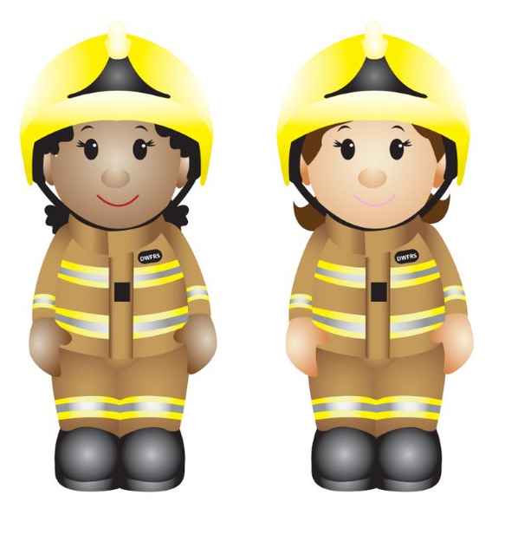
1
2
3
4
5
6
8
9
7
10
11

Slide 6
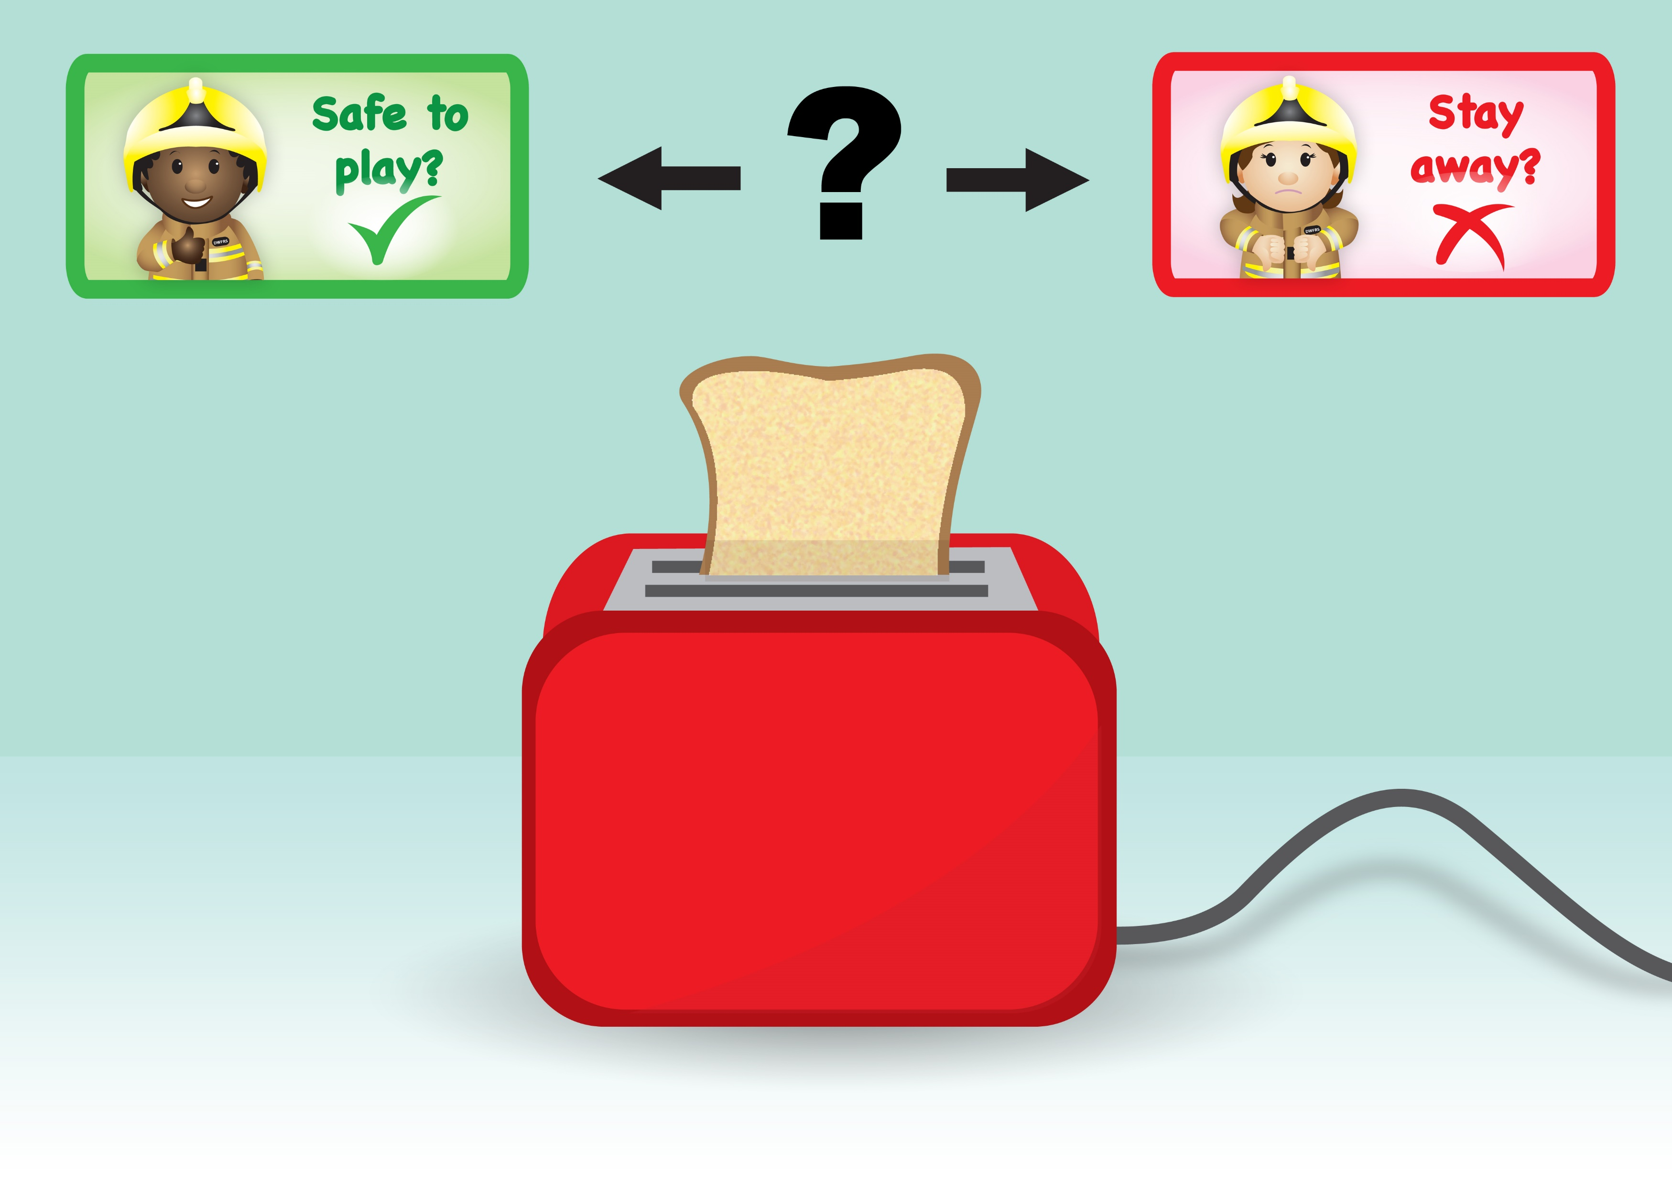

Slide 7
Notes:
The toaster can get very hot, especially the sides, so only the grown-ups should use it.
There are no flames or fire, but it is still hot enough to burn us.

Slide 9
Notes:
We should stay away from the candle.
Never play with candles.
Only the grown-ups should light the candles and make sure they blow them out when they have finished using them.
Keep candles away from other things that can catch on fire e.g. curtains.

Slide 10
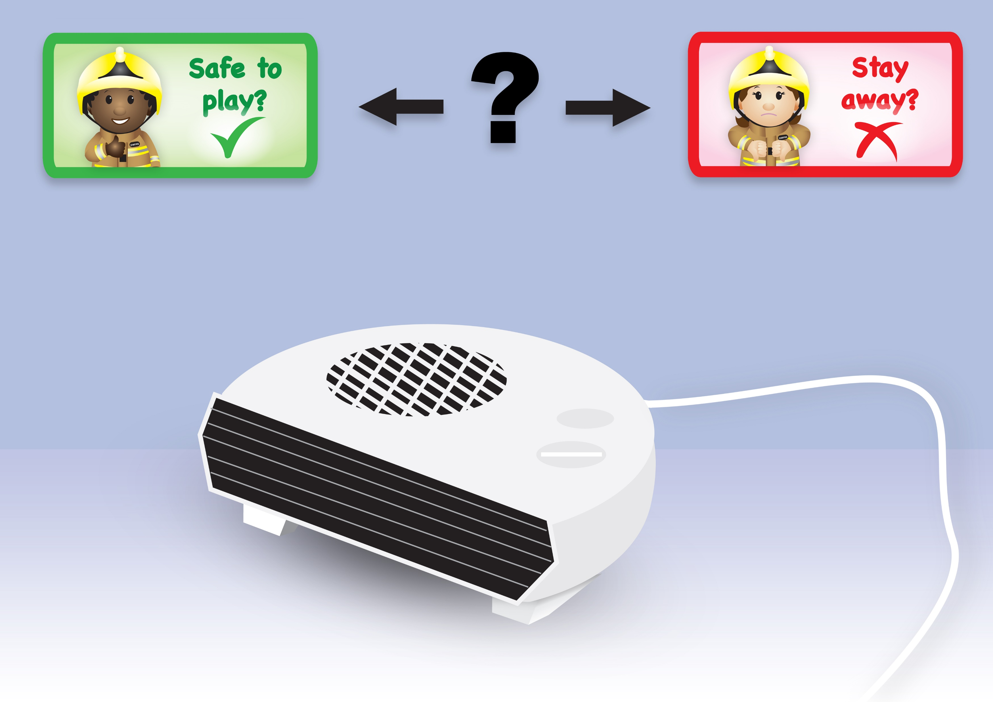

Slide 11
Notes:
We should stay away from the electric heater as it can get very hot and burn you.
We must also make sure we don’t put anything on top of it or near it, like a jumper, as this could make it too hot and a fire could start.

Slide 12
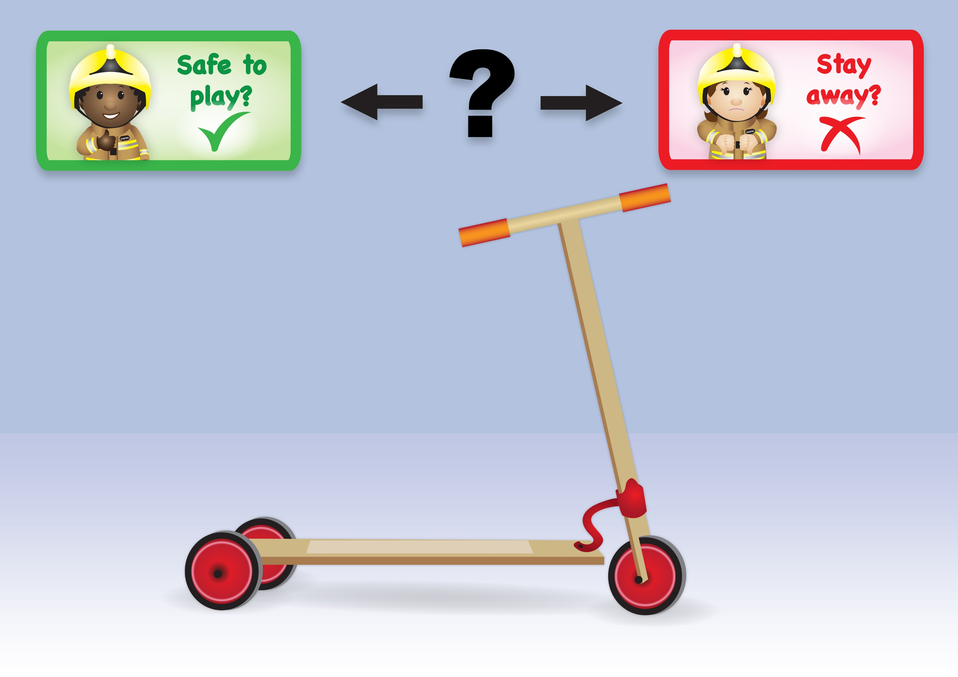

Slide 13
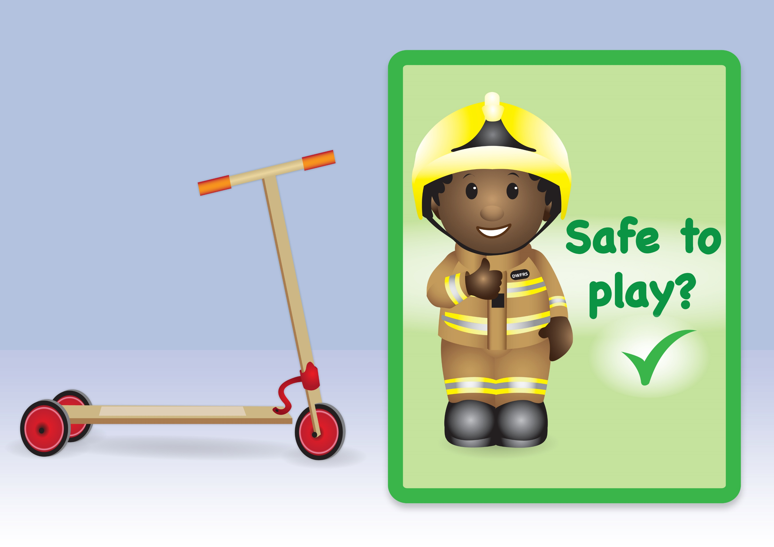
Notes:
Your scooter is safe to play with.
But you must make sure you always wear your helmet, just like the firefighters wear theirs. This will protect your head in case you fall. Also, if you have them, wear elbow and knee pads.

Slide 14
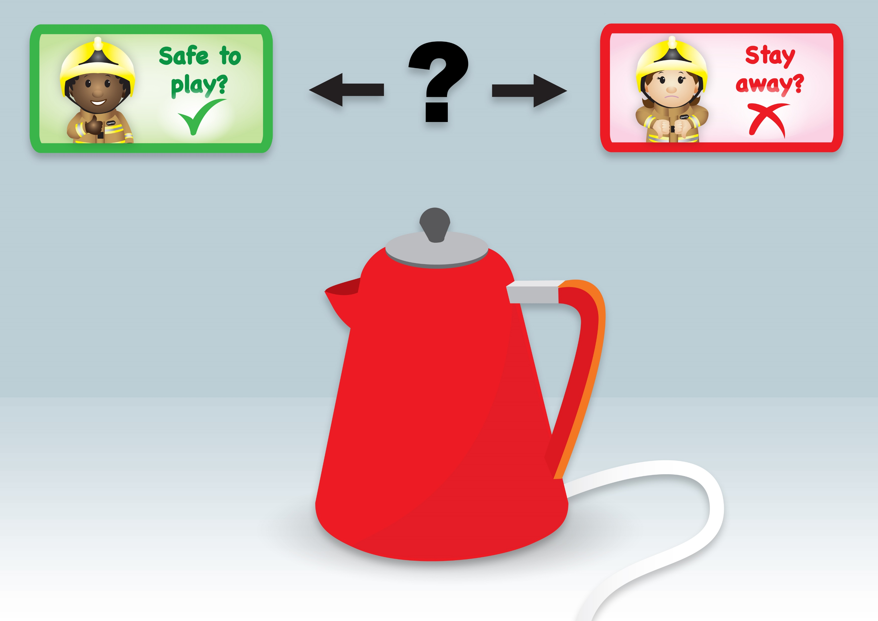

Slide 15
Notes:
We should stay away from the kettle as it can get hot. The water inside gets very hot and even the steam is hot enough to hurt you. Only the adults should use the kettle.

Slide 17
Notes:
We should stay away from matches and lighters. Only the grown-ups should use the matches and lighters.
We should never play with them as they could start a fire.
If you have listened to the story, you can remind them of the rhyme they learnt. If you haven’t listened to it yet, you can teach them the rhyme. “Matches lighters never touch, they can hurt you very much!”.
Your grown-ups should keep the matches and lighters in a safe place, high up, out of your reach.

Slide 18
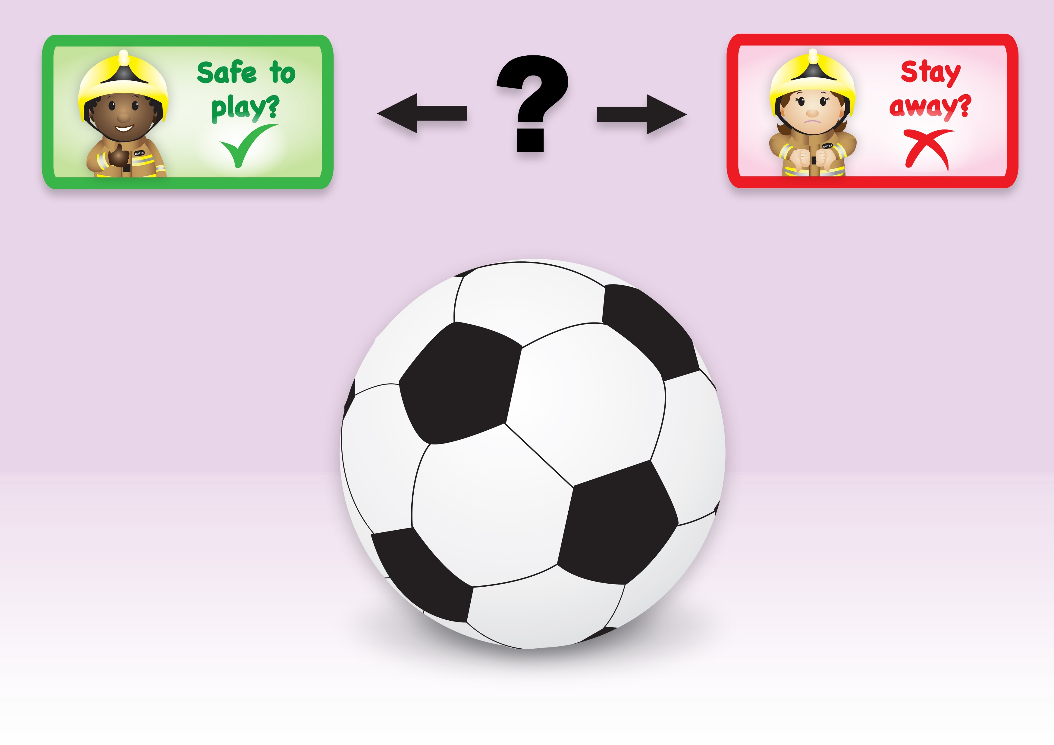

Slide 19
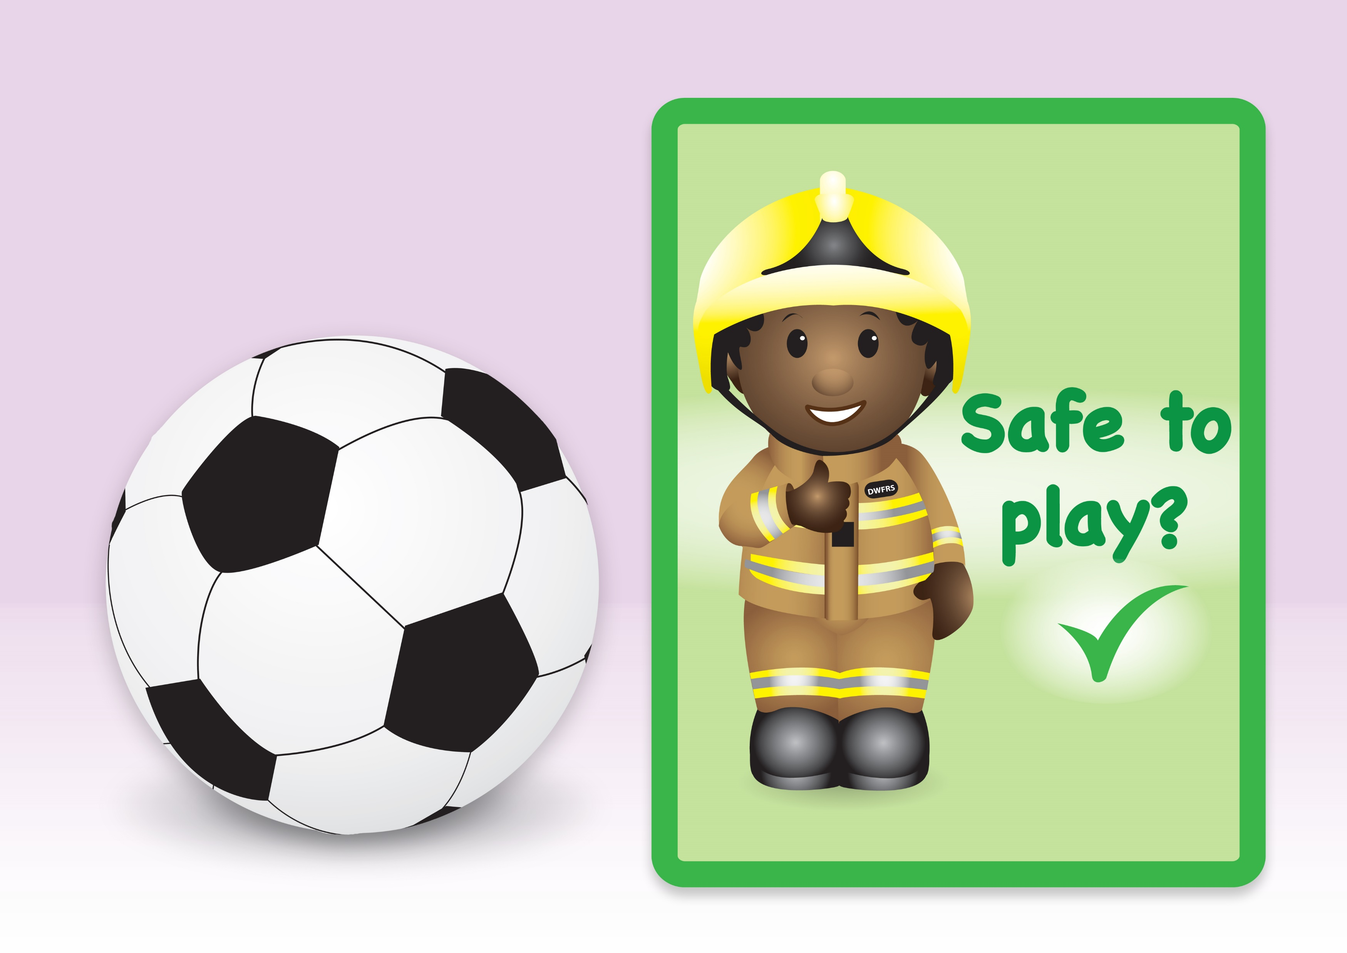
Notes:
The football is safe to play with. It is a toy.

Slide 20
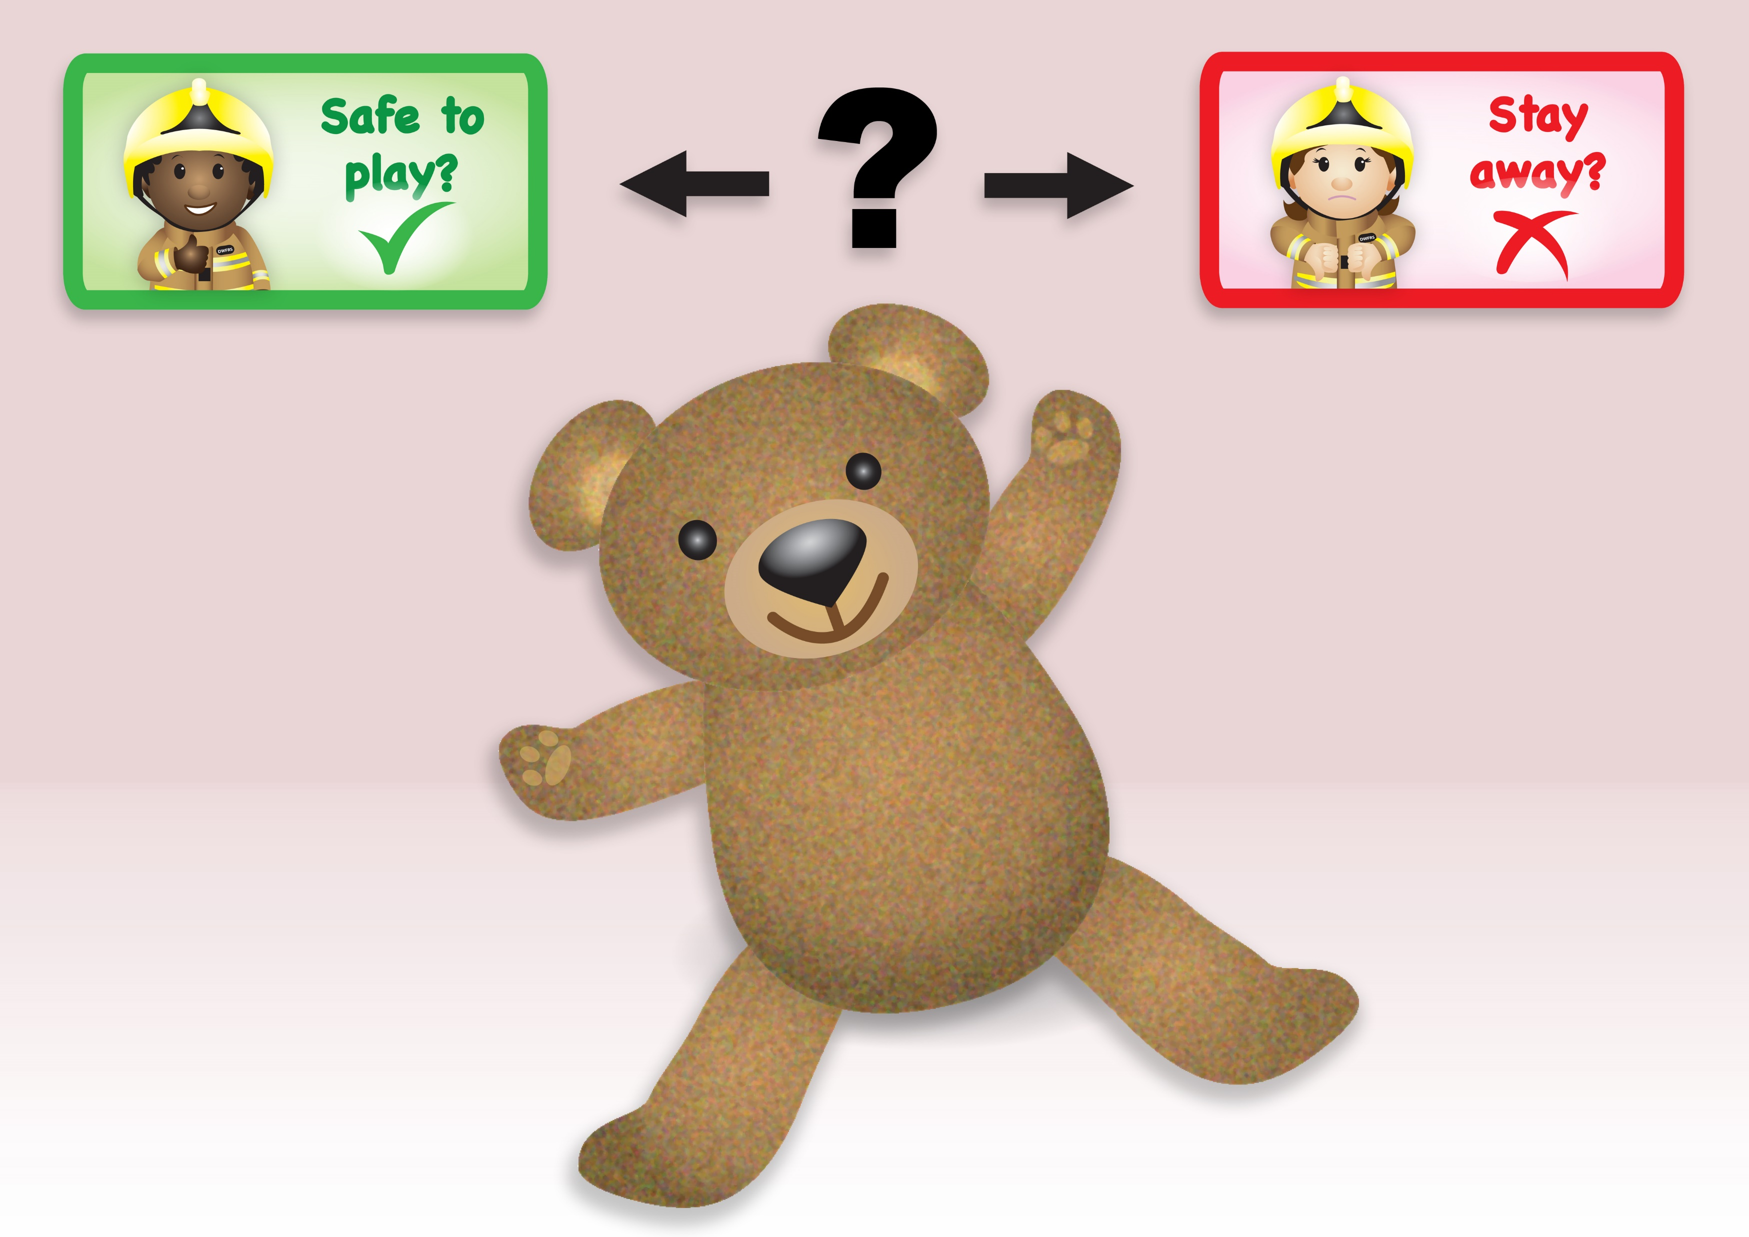

Slide 21
Notes:
The teddy is safe to play with as it is a toy.

Slide 22
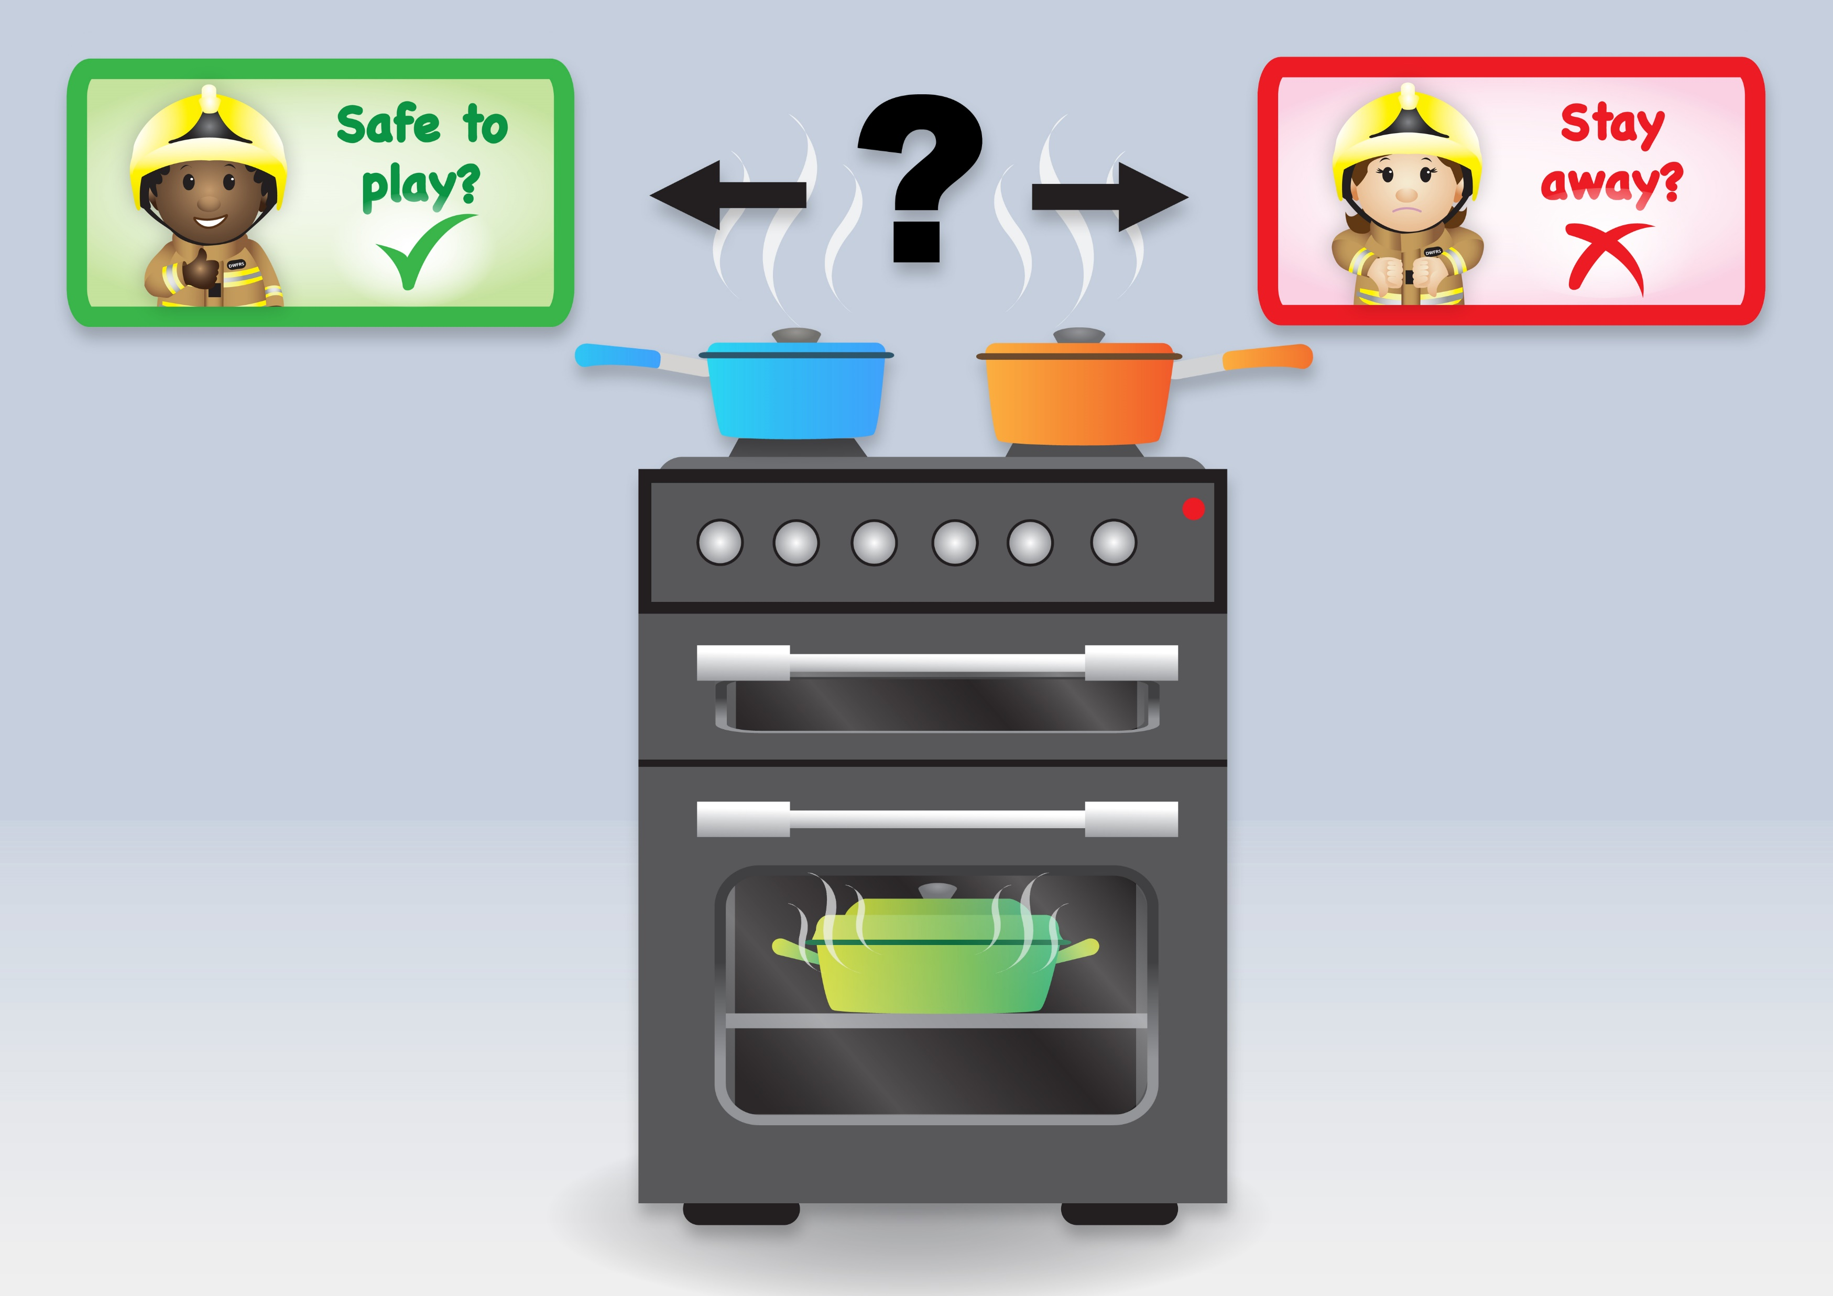

Slide 23
Notes:
You should stay away from cookers as they can get very hot, so we don’t play near them.
Make sure the handles of the saucepans are pointing away from the edge, like in the picture. That is so no one accidently grabs them or knocks them and ends up with boiling food or water on them.

Slide 25
Notes:
You should stay away from the hair straighteners as they can get very hot, as hot as your oven.
They take a long time to cool down and even once they are switched off, they can still burn you.

Slide 26
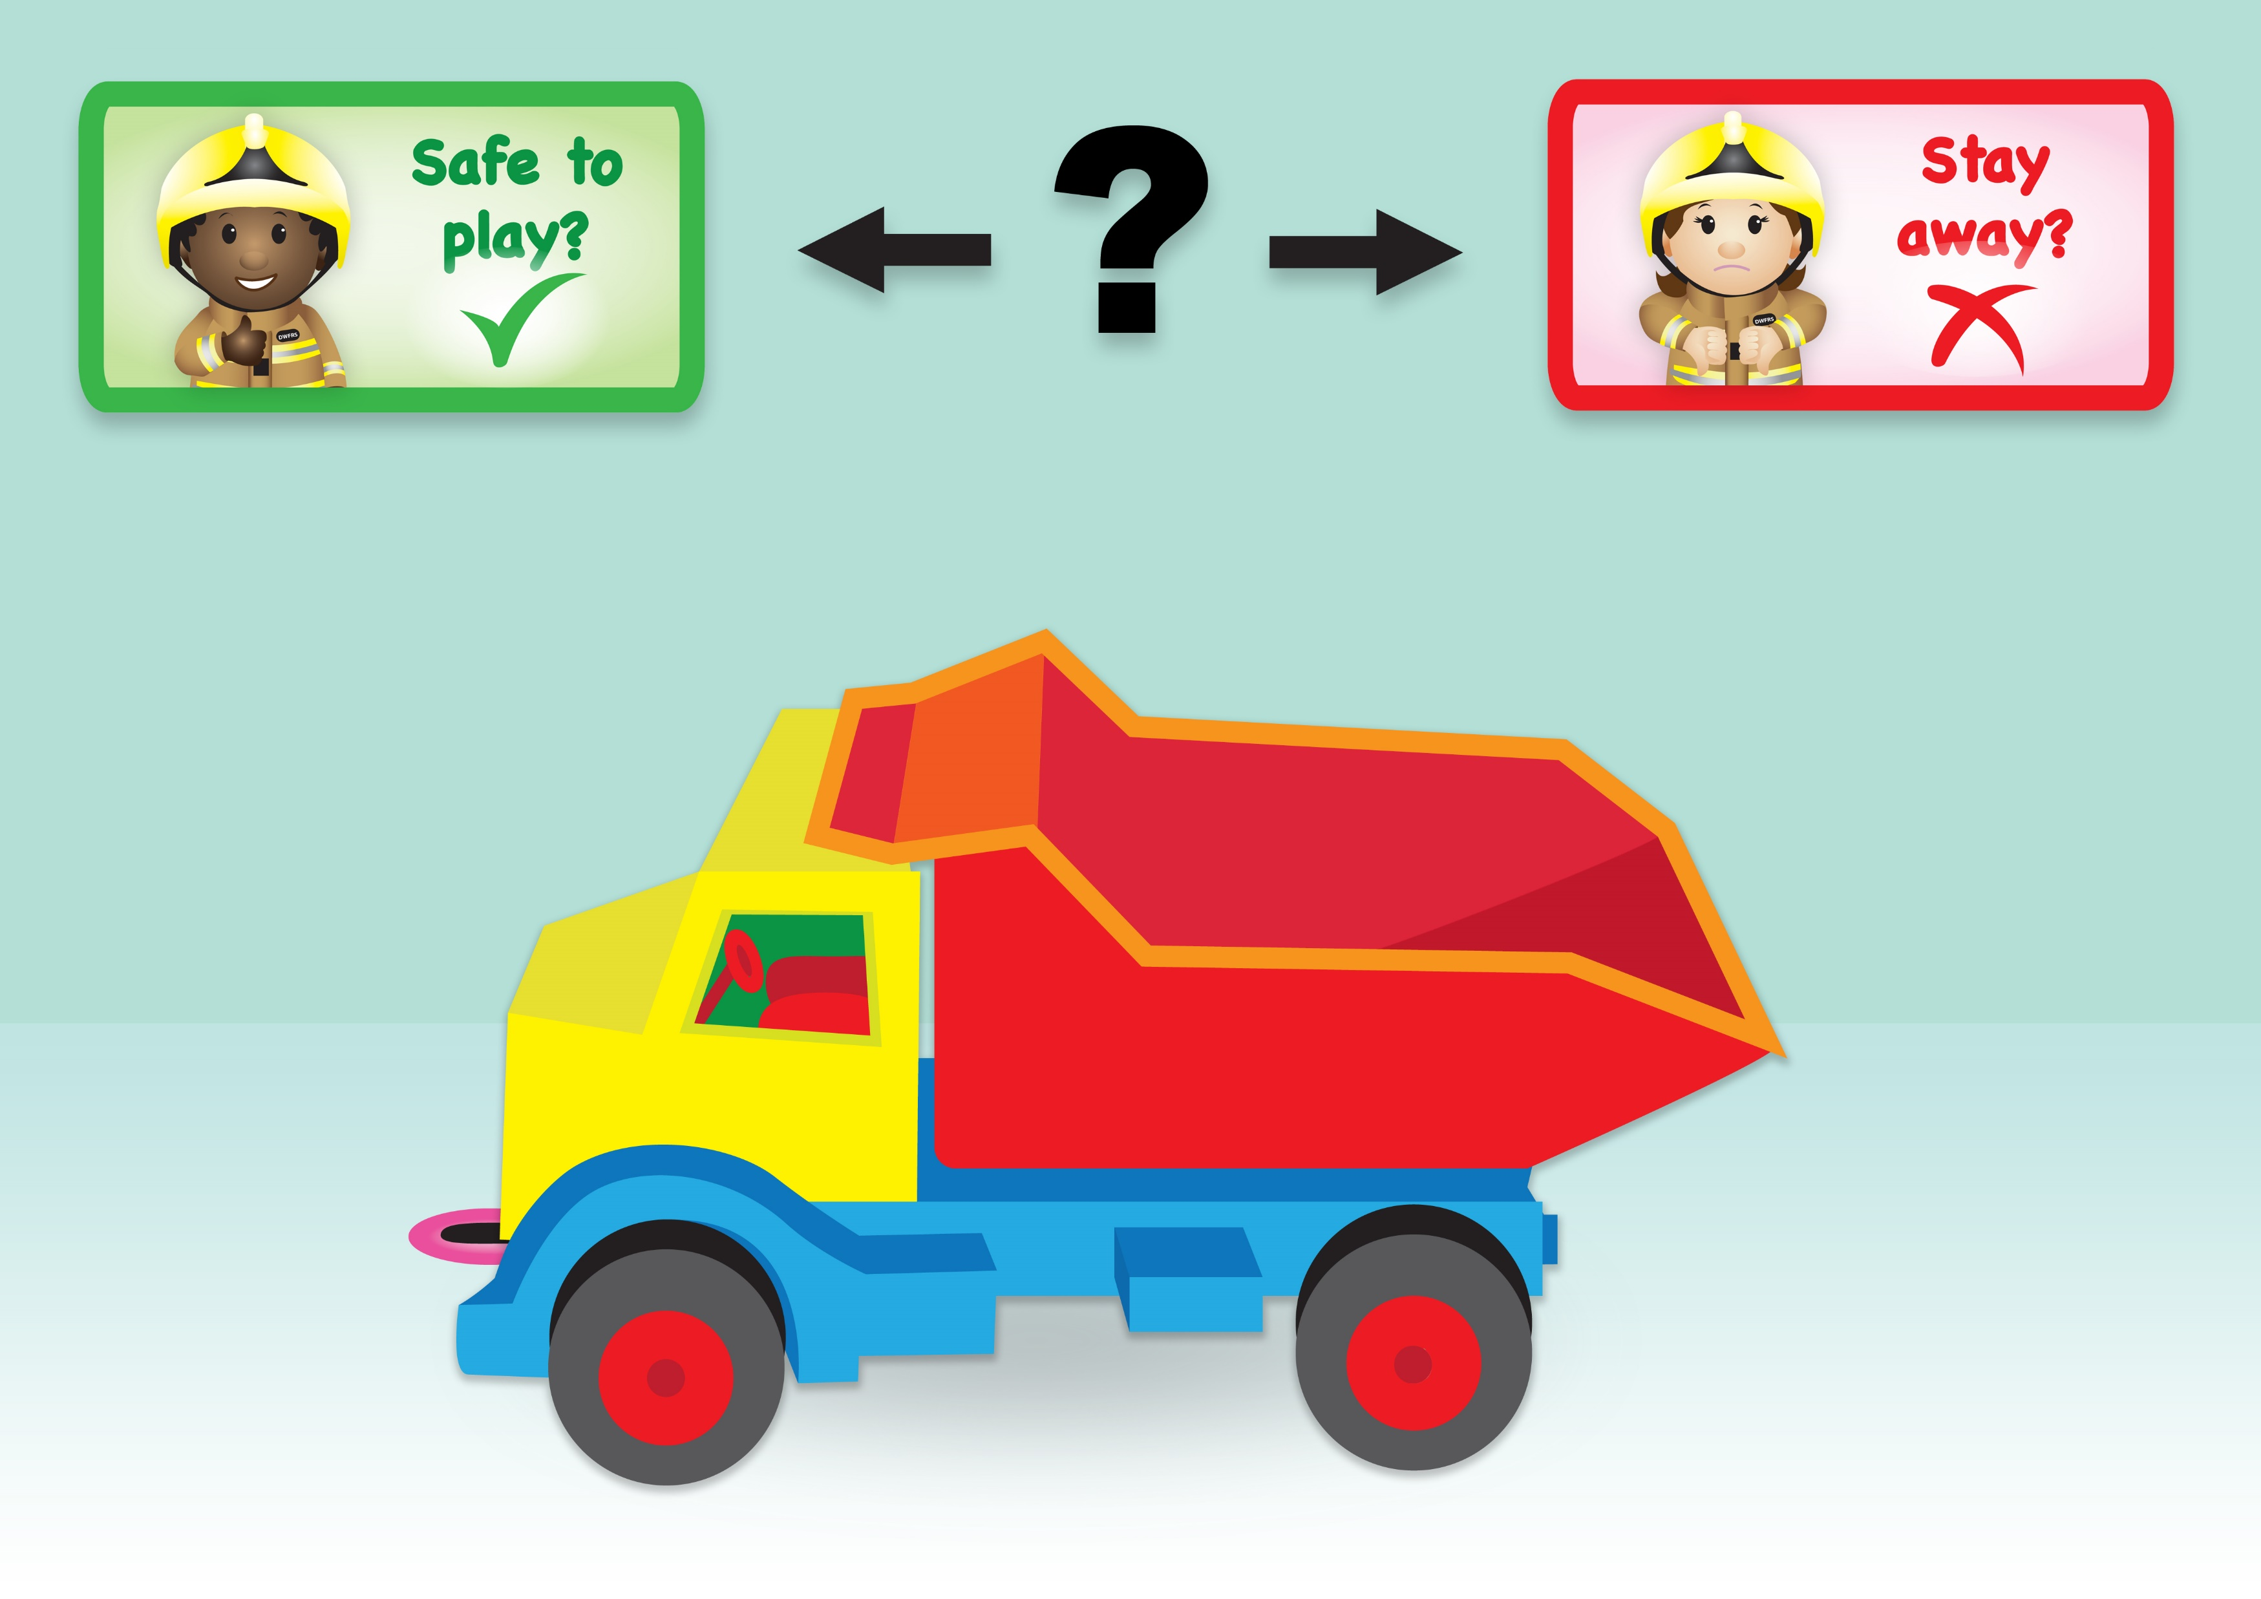
Notes:
This is safe to play with as it is our toy.

Slide 27
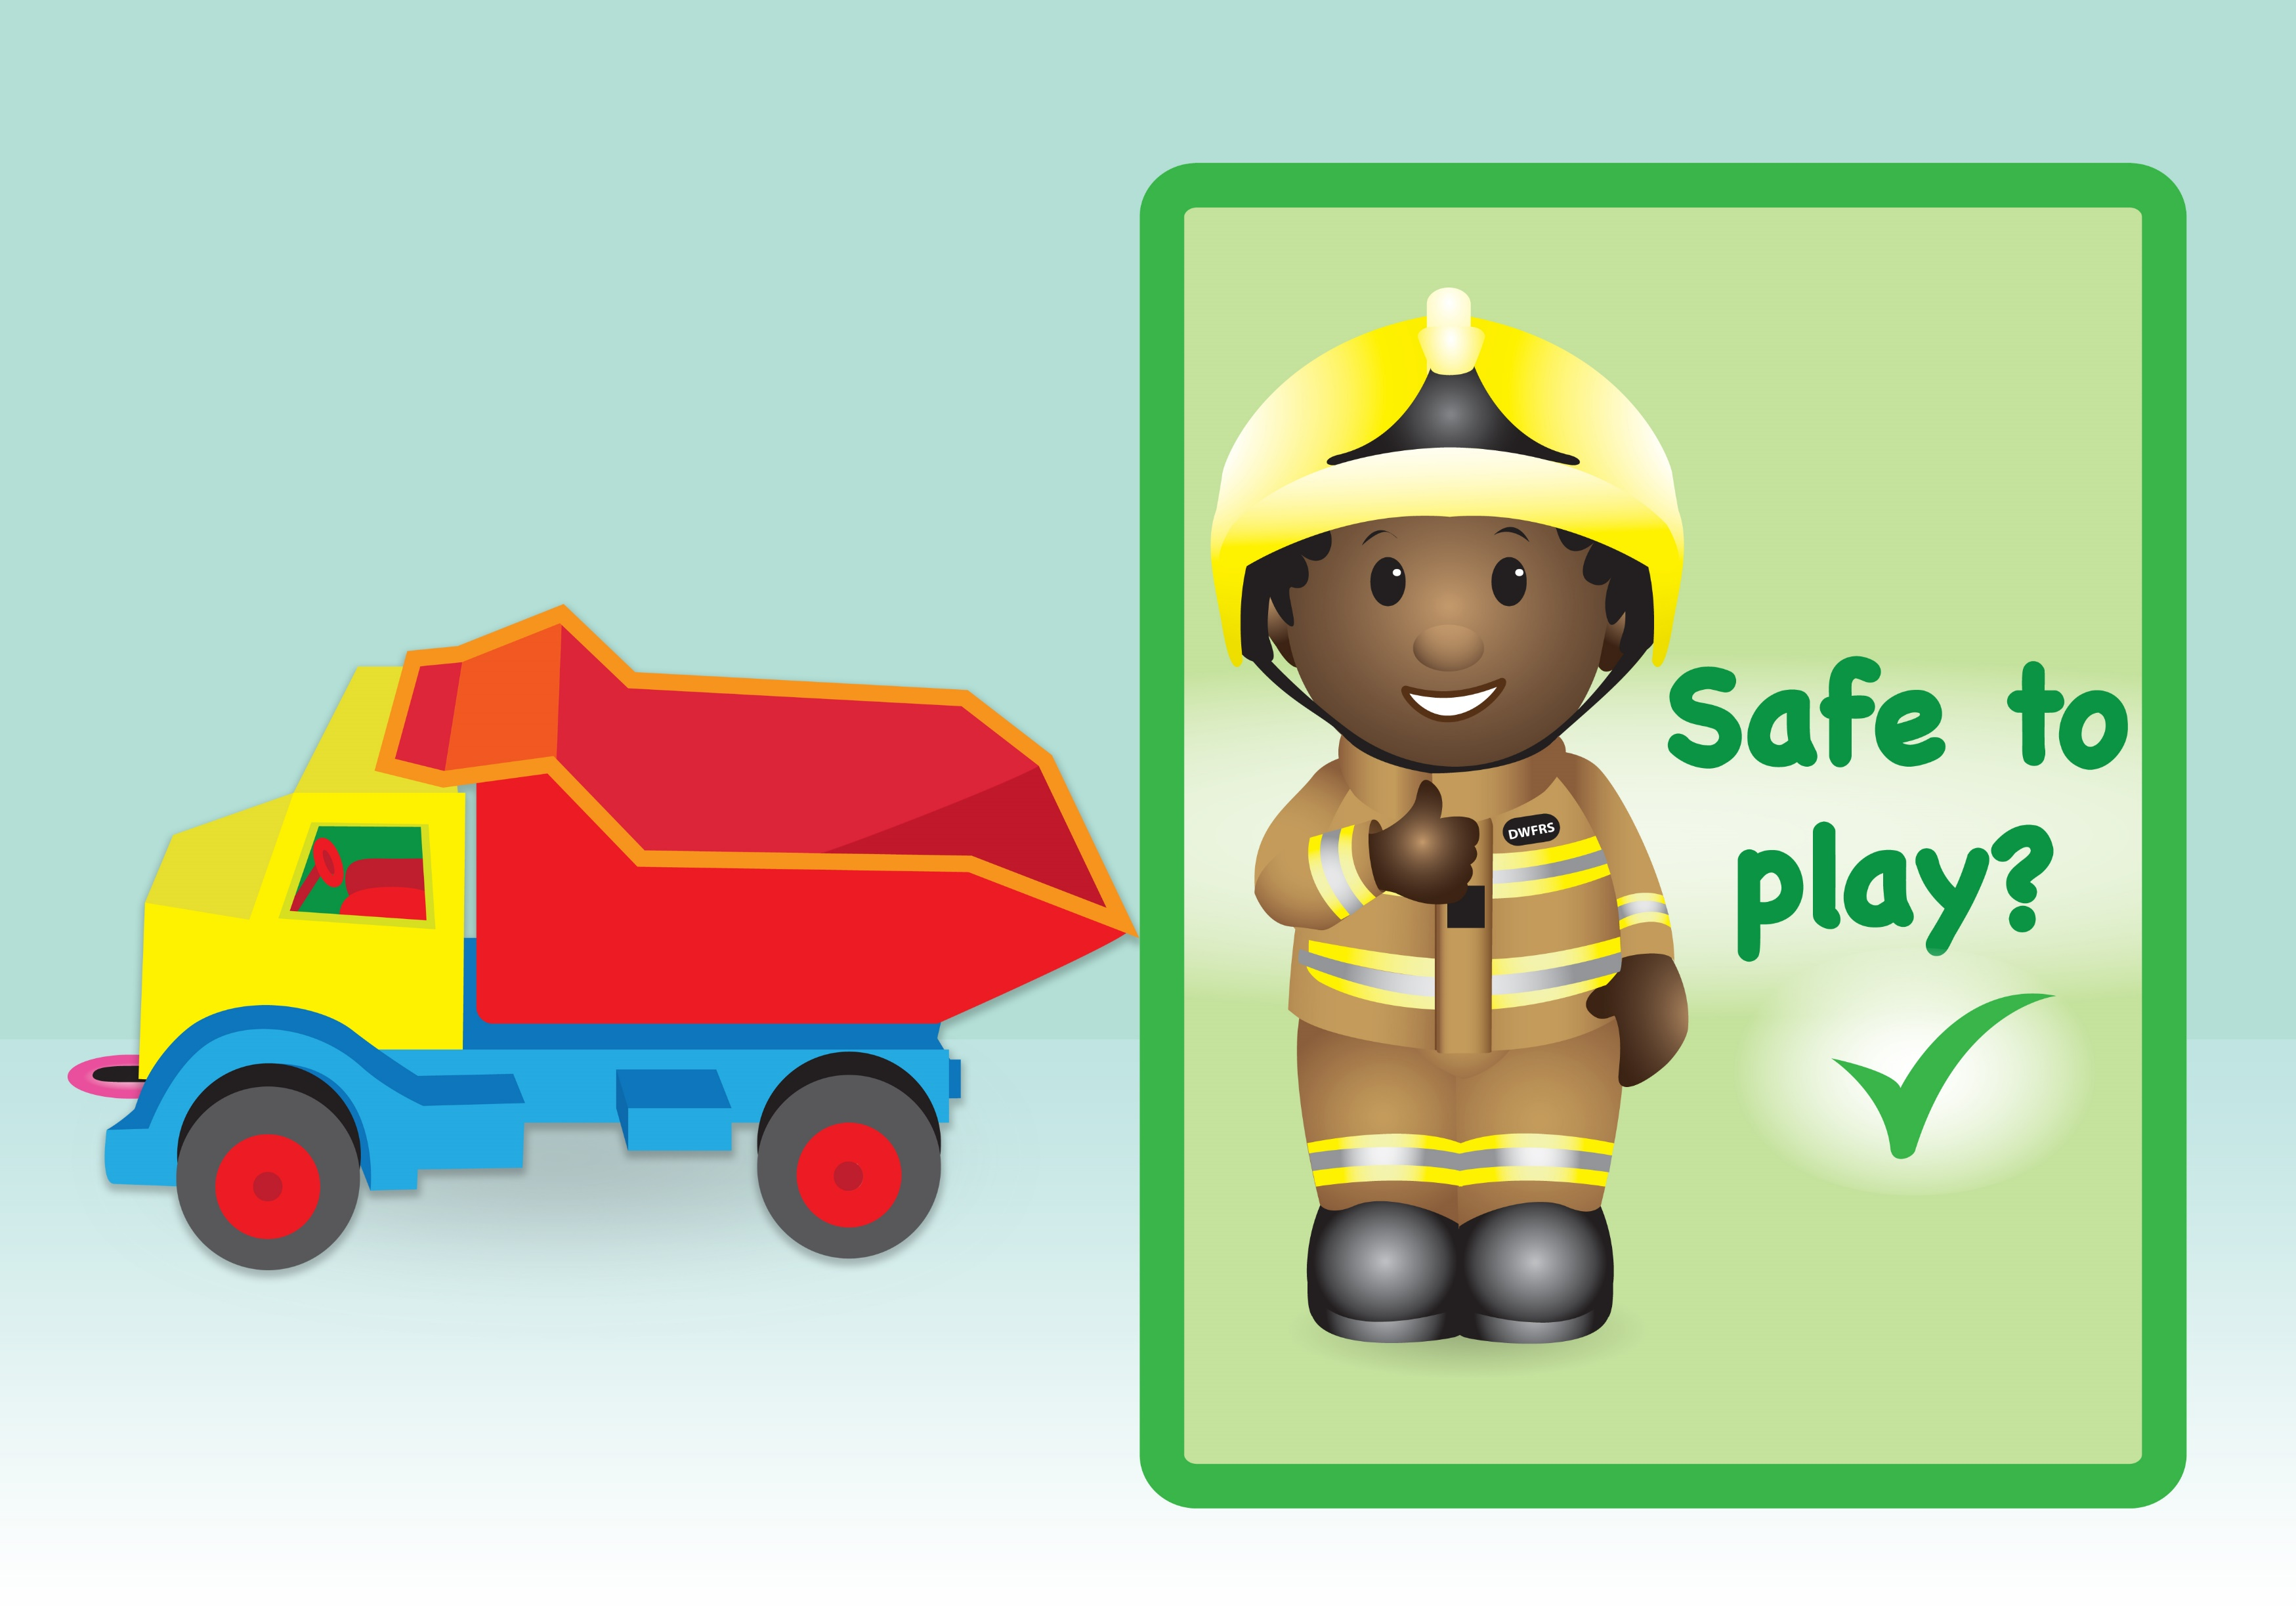
Notes:
This is safe to play with as it is our toy.

Slide 28
Notes:
Toys are safe to play with but stay away from anything hot.

