Slide 2
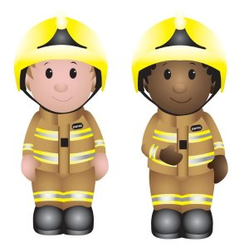
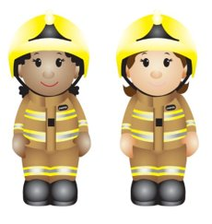
Grandad’s Birthday
Safety Story
Firefighter Heather’s
Safety Messages

Slide 3
Listen to Firefighter Heather
read you a story
Grandad’s Birthday

Slide 4
Firefighter Heather’s
safety messages
Safety messages

