Slide 1
Be Aware & Take Care
Be Aware and take Care
Firefighters

Slide 2
What do firefighters do?
What do firefighters have to help them?
What are firefighters like?
You can be a firefighter!

Slide 3
What do firefighters do?
Watch the playmobile firefighter’s video.

Slide 5
What do firefighters do?
Can you remember the three rescues the firefighters made?

Slide 6
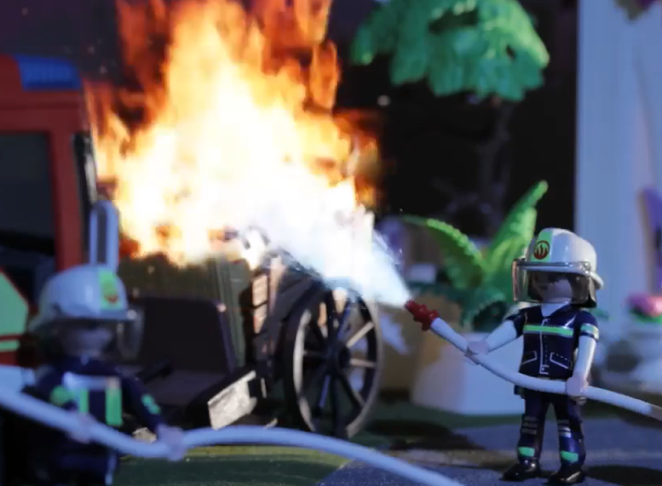
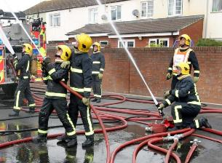
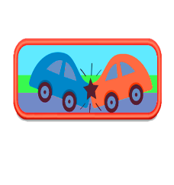
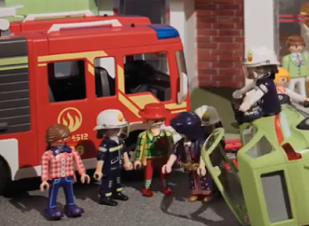
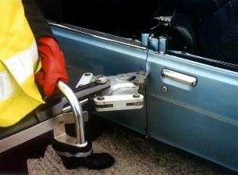
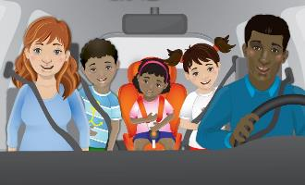
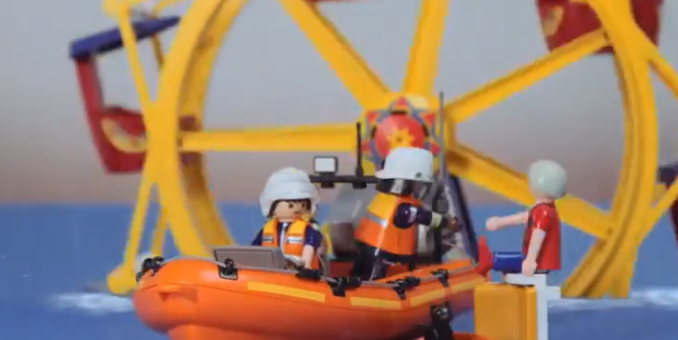
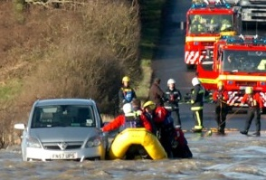
This Photo by Unknown Author is licensed under CC BY-SA

Slide 7
What do firefighters have to help them?
Watch Firefighter Heather.
What Firefighters Do - YouTube

Slide 8
What are firefighters like?

Slide 9
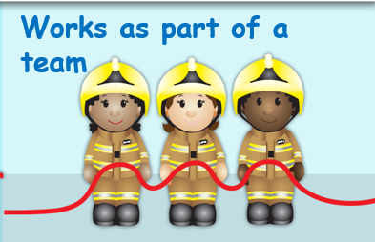
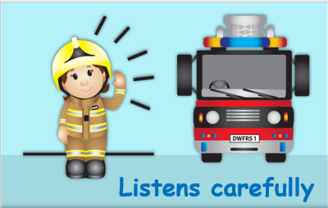
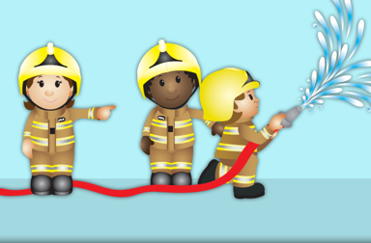
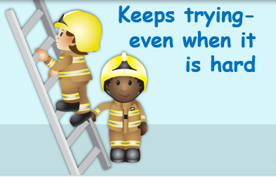
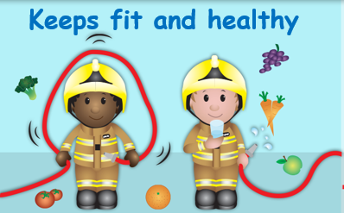
Does as they are asked
A firefighter ……….
Speaks clearly
Is brave

Slide 10
Does as they are asked
You ……….
Speaks clearly
Is brave

Slide 11
You can be a firefighter!
Now you know what firefighters do and what a firefighter is like, let’s have a go!

Slide 12
Join in the actions in the video
Firefighter Actions

Slide 13
You can be like a firefighter.

Slide 14
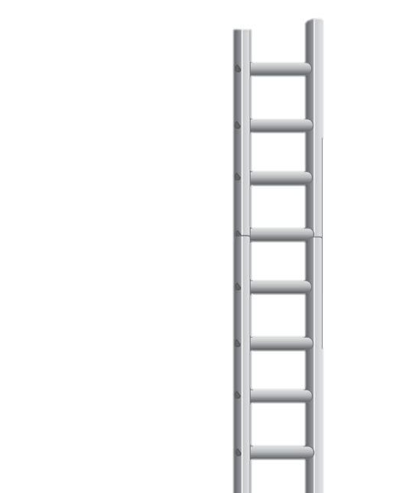
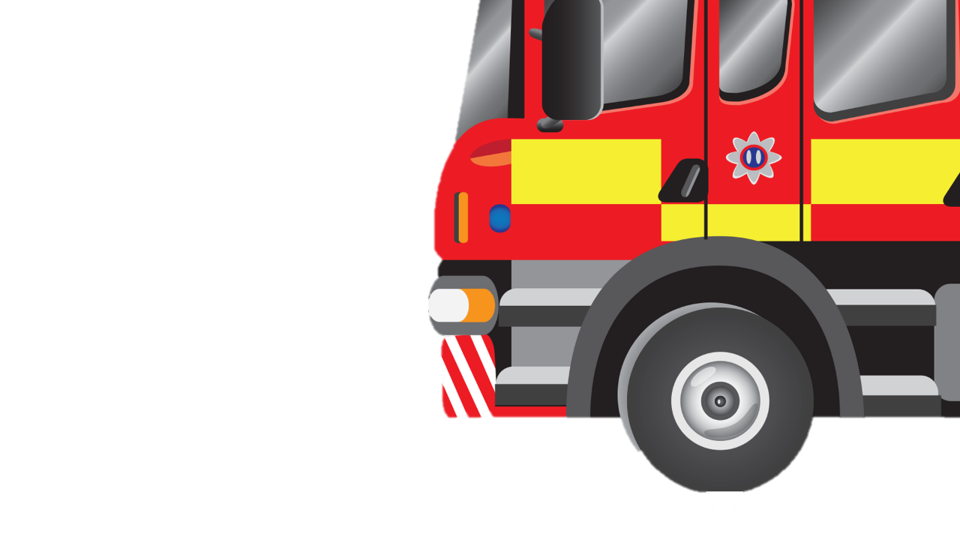
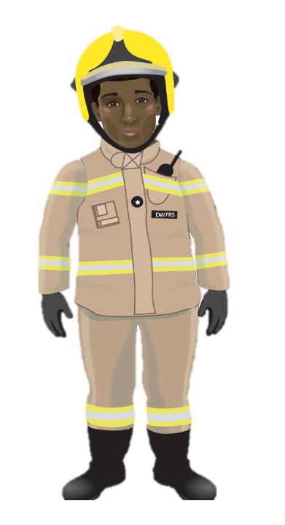
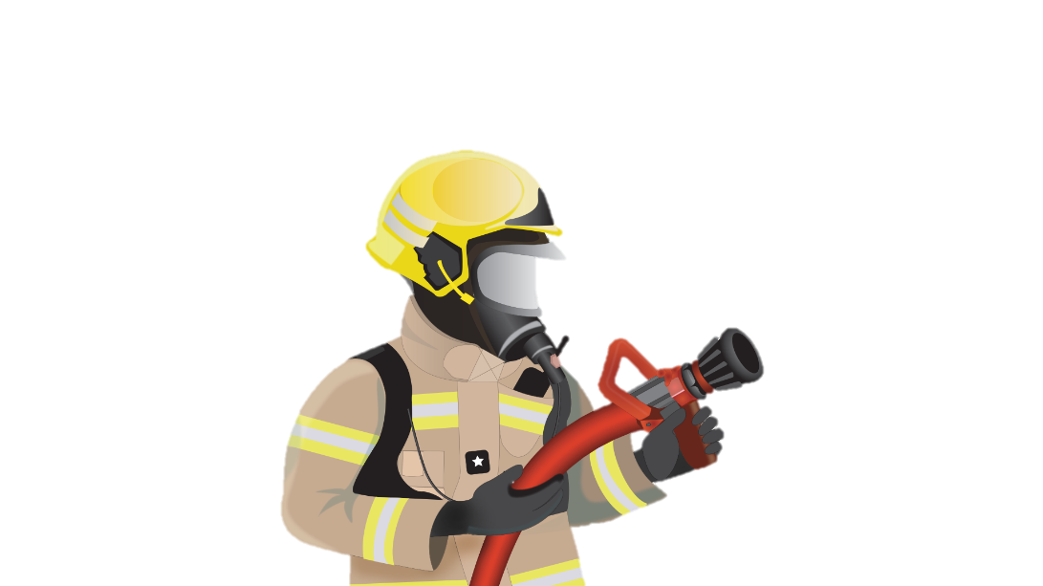
1
Put on your fire kit
2
Drive the fire engine
4
use the hose
3
Climb the ladder

Slide 15
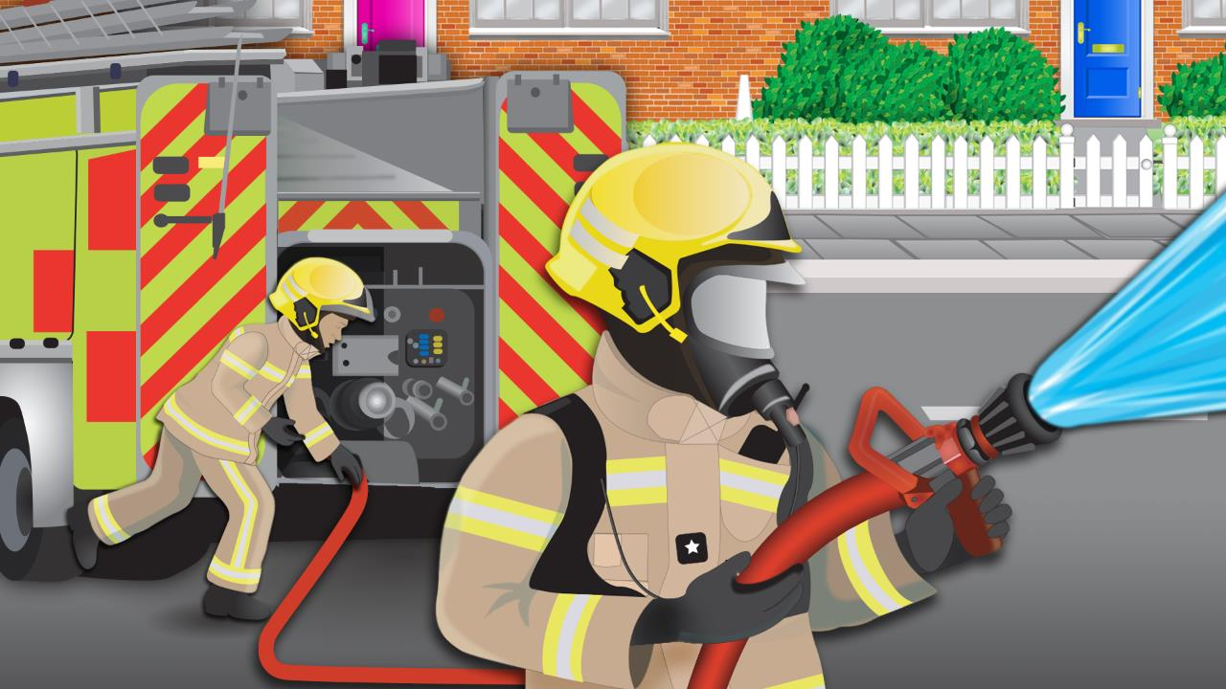
What is a firefighter like?
brave
encouraging
teamwork
perseveres
trustworthy
Kind and thoughtful
speaks clearly & carefully
respectful
asks for help
follows instructions
keeps fit and healthy
listens carefully
Notes:
Before very long down our street there came sailing
With bright red lights flashing and loud sirens wailing
The fire crew came to set work on their task,
They were dressed in big boots they wore helmets and masks.
They hooked up the hose and ran into the house
And sprayed streams of water in order to douse,
The table the curtains our lovely snack too
And it didn’t take long till the fire was through.

