Slide 1
Be Aware and take Care
Be Aware & Take Care
Escape Plan

Slide 2
Watch and join in the actions of the fire escape video
Fire escape plan actions
Please note, a smoke alarm will sound on this video.

Slide 3
Escape plan order

Slide 4
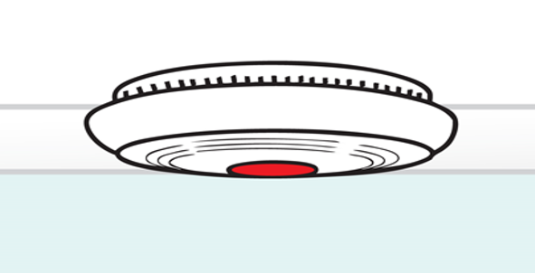
Your smoke alarm sounds

Slide 5
Feel the door with the back of your hand

Slide 6
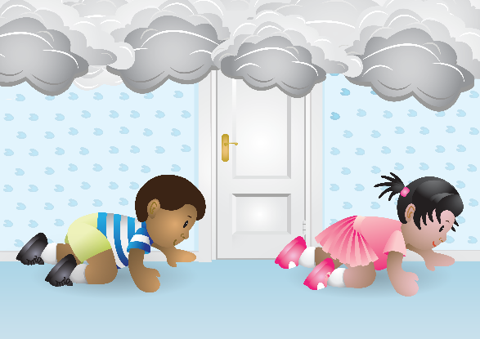
If there is smoke:
Get low and go under the smoke.

Slide 7
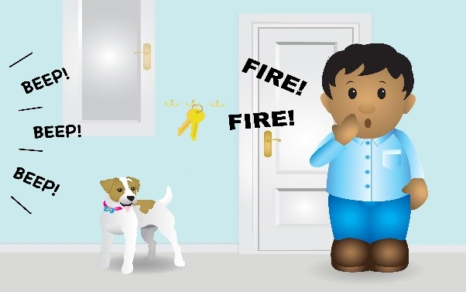
Have keys by the door so you can get out

Slide 8
Go to your meeting point.

Slide 9
When outside call 999

Slide 10
Wait for the firefighters

Slide 11
Be Aware & Take Care

