Slide 2
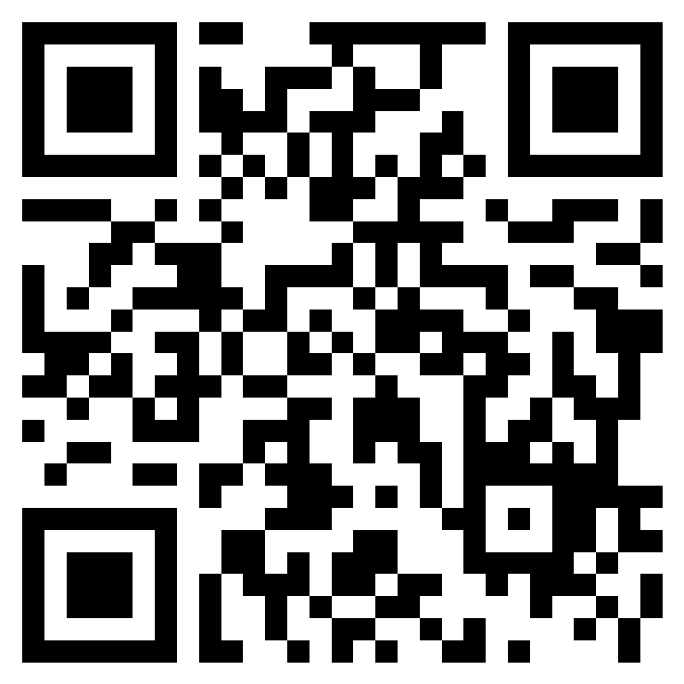
Introduction
By the end of this session you will be able to:
Identify how peer relationships can impact driving behaviours both positively and negatively including:
Wearing a seatbelt
Travelling at appropriate speeds
Being distracted
Driving under the influence of drink and drugs
Use techniques to address driving behaviours you feel uncomfortable with as a passenger to keep yourself and other travellers safe
Self Care
Ground rules
Questionnaires
Notes:
3 MINS (Slide 2)
Share learning objectives
Discuss self-care and pastoral support available: this subject may trigger students. Please ask them to take care of their welfare and that of their peers. Check if anyone in has been affected by a Road Traffic Collision – are they happy to stay? What should they do if they are affected by anything during the lesson?
Set Ground Rules for session: We recommend kindness, empathy, respect and speaking one at a time. Check if is there anything they would like to add – write on board
Questionnaires: It’s important DWFRS learn how effective today was so please complete pre-questionnaire before starting. A post questionnaire will be completed at the end.

Slide 3
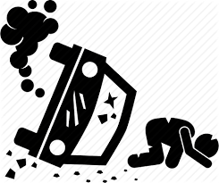
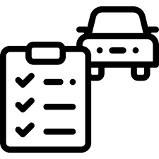
Why we are here
17-24 year olds make up 5% of drivers but over 20% of KSI
1 in 4 18-24 year olds crash with 2 years of passing test
Young male drivers are involved in more crashes than young female drivers
Notes:
2 MINS (Slide 3)
Explain that this lesson is a follow up to Safe Drive Stay Alive using Virtual Reality. Students are going to watch two Virtual Reality films, discuss them in pairs or groups and how our safety on the roads is determined by our choices: good choices lead to positive outcomes.
Aim of activity is to help students make good choices as drivers or passengers by equipping them with tools to feel empowered to do so.
Go through stats on slide.
Research has found that young drivers are more likely to take many of the most serious risks, including speeding, overtaking blind, driving on drugs, and not wearing seat belts. This is because the frontal lobe, the part of the brain that helps control impulses and emotions and assesses risk, is not fully developed until our mid-20s.
Young people also underestimate certain high-risk behaviours, e.g research shows that young drivers are less likely than older drivers to rate speeding as high risk.
From all the collision data and police investigations we can identify the four most common causes of injury and death in a road traffic collision. Do you have any thoughts on what these might be? Note ideas from students.
We will look at the causes in a little more detail after the video we are about to watch.

Slide 4
SDG 3 target 3.6 – By 2020, halve the number of global deaths and injuries from road traffic accidents.
SDG 11 target 11.2 - By 2030, provide access to safe, affordable, accessible and sustainable transport systems for all, improving road safety, notably by expanding public transport, with special attention to the needs of those in vulnerable situations, women, children, persons with disabilities and older persons.
SDG 17 target 17.17 - Encourage and promote effective public, public-private and civil society partnerships, building on the experience and resourcing strategies of partnerships
Notes:
1 MIN (Slide 4)
Unpinning this lesson are the UNSDGs. In 2015, 17 goals were agreed in a call to action to provide a model for peace and prosperity for people and the planet in global partnership. These are called Sustainable Development Goals.
Today we are working in partnership with Arval towards SDG 3, which is to help halve the number of global deaths and injuries from road traffic accidents

Slide 5
Choice
Outcome
Good
Indifferent
Poor
Intended
Unintended
Responsible
&
Accountable
Notes:
1 MIN (Slide 5)
Reiterate that getting your licence is amazing, exciting and gives you incredible freedom, however driving is one of the most dangerous things you will ever learn to do. Through every choice that is made as a driver or passenger, there is an outcome. Depending on how well or poorly (or indifferently) you make that decision, you are still responsible and accountable for the outcome - whether it was intentional or not.

Slide 6
Ready… Head set… Go!
Has anyone in the room ever had epilepsy or a seizure?
Please remain seated while the film is playing. You may feel disorientated but If you feel unwell, please remove the headset carefully and let us know
Glasses? Try to fit the headset over them
PLAY FILM
Notes:
2 MIN (Slide 6)
You’re about to watch a 2 minute film. Before we do…… Talk through slide…
STUDENTS TO WATCH 1ST FILM

Slide 7
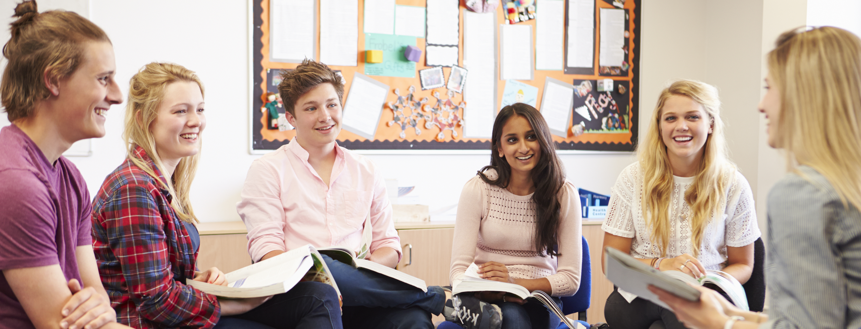
With the people sitting next to you
discuss the following…
What actions contributed to the incident occurring?
What could you have done as that passenger to change the outcome?
What could the driver have done to avoid the incident happening?
Notes:
5 MINS (Slide 7)
Check welfare… go through questions
(5 mins) Facilitate discussion in pairs or groups

Slide 8
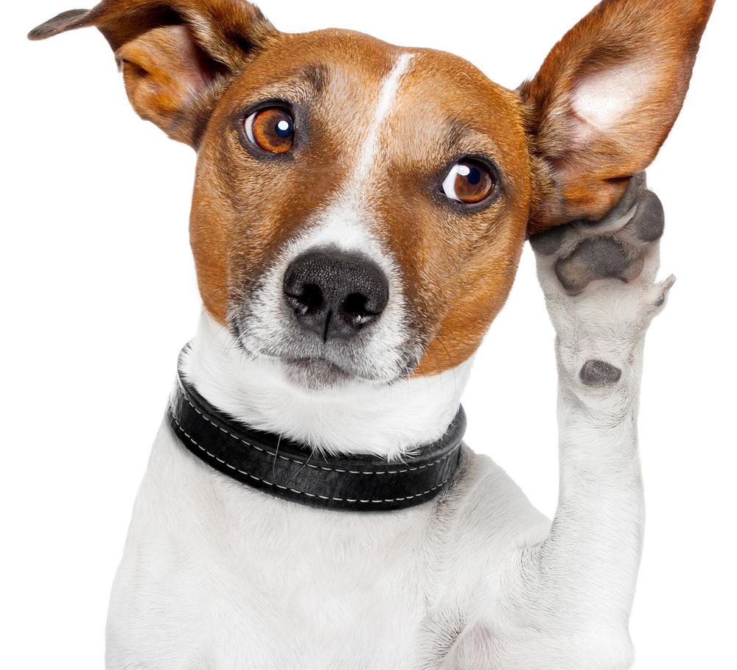
Let’s hear your thoughts
Notes:
5 MINS (Slide 8)
Collect feedback: Students should have noted that seatbelts, use of mobile phone/distraction and speed were key factors causing the incident.
What could you have done as that passenger?
What could you have done as the driver?
Record ideas on flip chart/board.

Slide 9
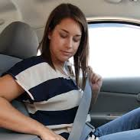
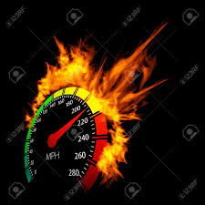
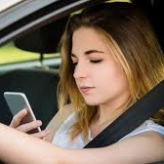
The Fatal Four
Notes:
(6 mins)
The 4 most common causes of death or serious injury in a collision according to police investigation data are:
(Select stats to read from each of the below)
Not wearing seatbelts
95% of people wear a seat belt in the car, but 25% of all fatalities on our roads are people who weren’t wearing theirs.
The age group least likely to wear one are 17-24 year olds who are travelling with their peers and going on short journeys.
As 1 in 3 crashes happen within a mile of the driver’s home, even on short journeys, seat belts are essential.
Since their invention, seat belts are estimated to have saved over 1 million lives worldwide.
Speed
Speed is a factor in every collision on the road. Regardless of any other factors or who is at fault, the speed you are travelling at will affect the severity of any collision.
An average speed reduction of just 1mph reduces crash frequency by 5%.
A crash at 30mph has twice as much energy and destructive potential as a crash at 20mph.
A pedestrian hit at 30mph has a 1 in 5 chance of being killed. This rises to a 1 in 3 chance if they are hit at 35mph.
A vehicle travelling at 20mph would stop in time to avoid a child running out three car-lengths in front. The same vehicle travelling at 25mph would not be able to stop in time, and would hit the child at 18mph. This is roughly the same impact as a child falling from an upstairs window.
3. Distractions
Research shows that using a hands-free system, impairs drivers as much as the use of a handheld phone, as the main danger arises from the distraction of the call, rather than from holding the device.
The crash risk when using a mobile can be greater than someone who is driving drunk.
Our reliance on our mobile phones and apps has meant that, even though driving can be a small percentage of our day, many of us find it hard to leave these devices alone while at the wheel!
You can be the best driver in the world but circumstances out of your control can change in a split second… someone stepping out in to the road, an animal running out in front of you, an oncoming driver being distracted and heading towards you, a tyre blowing or adverse weather etc. It’s important that your attention is on the road at all times.
4. Can you identify the last one? (confirm drink and/or drugs)
35% of people failing a breathalyser test last year were aged 17-24 years old.
Most people know not to drive after a heavy drinking session but would perhaps think it’s ok to have ‘just one'. Although in England and Wales you can legally drive if you have under 80mg of alcohol per 100ml blood, this is impossible for someone to judge. It depends on age, metabolism, and other unpredictable factors.
Generally, young people will be affected more by alcohol, so no amount of alcohol is ‘safe’ to drink before driving.
Alcohol and drugs stay in your system for far longer than most people realise and the effects of these continue for hours, even into the next day.
Check any medications you take to see if they cause drowsiness – your prescription should say, and if in doubt, ask your doctor or pharmacist.
As there is no way of knowing the true strength of any recreational drug that is taken, it is impossible to judge how soon someone would be able to drive after taking drugs. What we do know is that recreational drugs impair the parts of the brain that are used during driving such as vision, perception of speed and space, as well as reaction times.
Both alcohol and drugs can slow down reaction times by 25% - that will make a huge difference to stopping times.
You can be tested for both alcohol and drugs at the side of the road - they carry the same penalties (an unlimited fine, a driving ban, or in the worst cases, a prison sentence).
More people were arrested for drug driving than drink driving last year. Cocaine and cannabis are the drugs most commonly detected.
What are your thoughts on having a drink and driving - We know that there are legal limits but is it acceptable at all?
What would you do if you suspected your lift was under the influence of drink or drugs? (allow for discussion)
Has anyone been in this position? What did they do?
Again – it’s your choice but when you make good choices it will lead to positive outcomes.

Slide 10
Notes:
3 MINS
This film was made by Think! because Young men aged 17-24 are four times more likely to be killed or seriously injured compared with car drivers aged 25 or over – and young male drivers are more likely to crash with passengers in the car.
Research shows that peer pressure can encourage bad driving and result in drivers ‘showing off’ to their passengers and taking more risks. You’re up to five times more likely to die in a crash when carrying young passengers than when driving alone, but 62% less likely when carrying older adult passengers. This suggests that it is peer pressure rather than simply the presence of passengers that raises the risk. Young passengers can also cause distraction: teenage drivers are six times more likely to have a serious incident when there is loud conversation in the vehicle.

Slide 11
Choices and Decisions
Notes:
(7 mins)
PLAY NEXT VR FILM (4 mins) – Check everyone is ok after the film
Ask the class together to confirm the different decisions and changes that were made (3 mins)….
How did the driver address the behaviour of his passengers?
How did the passengers influence each other?
Re-emphasise that this lesson is about how good choices lead to positive outcomes.

Slide 12
Notes:
(2 mins)
PLAY FILM
This message is important and it shows a nice (almost funny) way you can challenge behaviour that doesn’t make you feel safe.
In road safety, the passenger seat has been referred to as the “sacrificial seat”. Self-preservation is human nature, so the most natural thing for a driver to do in the event of an accident is to swerve themselves away from danger, putting the passenger at risk… this is why this film asks drivers to think about the safety of their passengers and “put them first”.
Rhetorical questions but allow for interaction if it prompts response:
So as a driver, how could you challenge unacceptable behaviour of your passengers?
If you’re kind enough to offer people a lift, do you think you’re entitled to decide how people behave in it?
Do people have rules about eating in their car for example?
Is it therefore reasonable to ask people to wear their seatbelts or not distract you with their phones?

Slide 13
Your choice
Say Something
Ask them to Stop
Feeling unwell
Evaluate
Notes:
(7 mins)
If you find yourself in a situation where you’re not happy with travelling in a car, you do have options! This acronym spells “SAFE”
On “Evaluate”: Let’s say you’re already travelling in a car and there is behaviour that does not make you feel safe…. What are your other options?
(allow discussion as a class and use the following as prompts)
Can someone else pick you up?
Do you have money for a taxi?
Have you had this conversation with the people you live with?
Give choice of activity for the last couple of minutes:
In pairs or small groups, take a few minutes to think of a #, a slogan or an acronym to help someone if they find themselves in this situation as a passenger OR
Come up with a set of rules that you as a driver would set for passengers in your car
If you come up with something quickly, you can get a head start and complete the post questionnaire.
Ask groups to shout out ideas after 3 mins and write them on the board/flipchart.

Slide 14
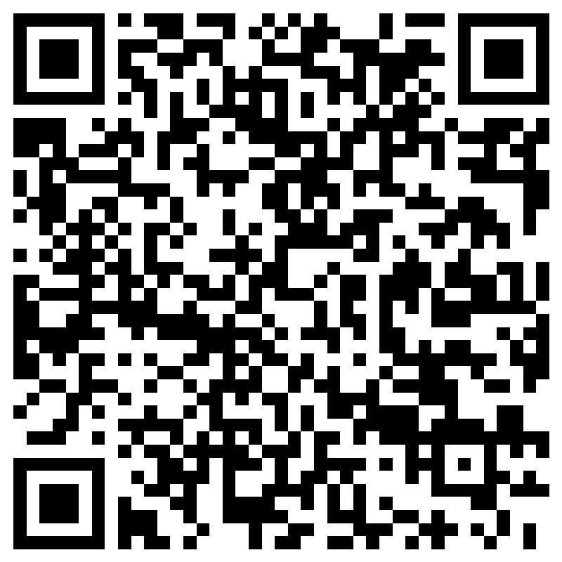
Please complete your post questionnaire
follow us @dwfirerescue
#beamatekeepmesafe
Notes:
FINAL SLIDE (14)
Please thank students on our behalf and ask to complete questionnaire.
@dwfirerescue are on Instagram, Facebook, X and TikTok. They welcome your campaign ideas on there so you can help empower others to keep themselves and their friends safe. Remember to tag Arval UK
and include our #beamatekeepmesafe

