Slide 1



Road safety

Slide 2
It is important to
know how to keep yourself
safe on the roads….
…in a vehicle

Slide 3
Why do I need to wear a seatbelt?

Slide 4
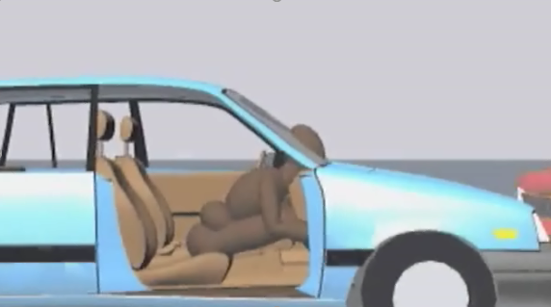
Without a seatbelt.

Slide 5
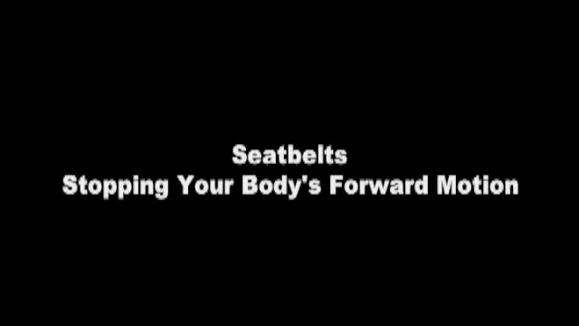
Notes:
Video should run by itself: showing what happens when not wearing a seatbelt

Slide 6
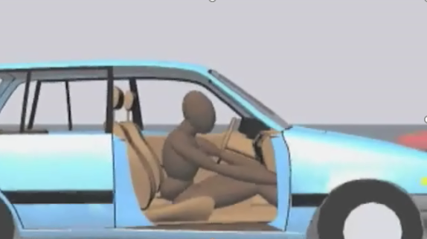
With a seatbelt.

Slide 7
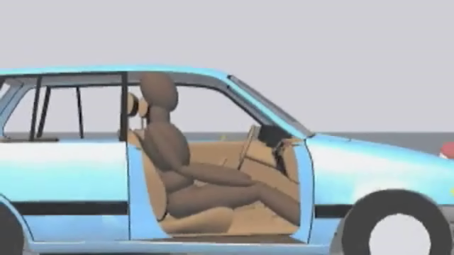
Notes:
Video should run by itself . Wearing a seatbelt – head does not go through the windscreen

Slide 8
Wear a seatbelt to keep you safe.

Slide 9
Why should I behave in the car?

Slide 10
The driver needs to concentrate when driving

Slide 11
Messing around =
less concentration on driving

Slide 12
Each time I say “Look”
look behind you for a moment.
Notes:
When watching the video (sound is needed to explain), a couple of times say “look” to get the children to look behind as if they were looking at someone in the back seat of a car

Slide 13

Notes:
Video should play by itself, ask the children to look behind a couple of times . How many passes did they see?

Slide 14
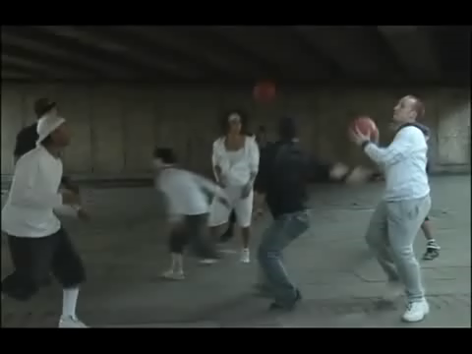
Notes:
Video should play by itself – did anyone get 13 passes? It is easy to miss something if the driver is turning round. Did anyone spot the bear? Unexpected things can happen on the road, it is important that the driver concentrates at all times. For example someone could try to cross the road, an animal could run out into the road

Slide 15
If the driver is looking back at you, they can not concentrate on the road ahead.

Slide 16

This is also why drivers should not use mobile phones when driving

Slide 17
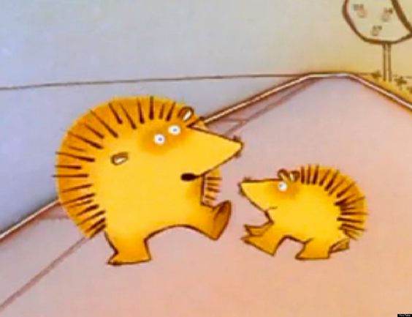
It is important to
know how to keep yourself
safe on the roads….
…when walking

Slide 18
What is there to help me cross the road safely?

Slide 19
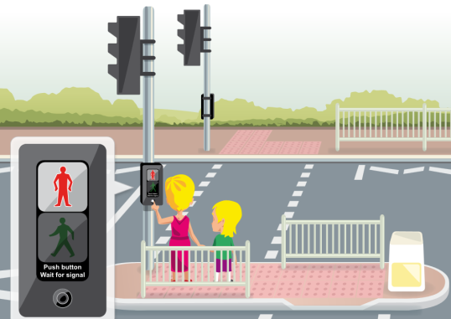
Red man = Stop
Green man = Go if it is safe.

Slide 20
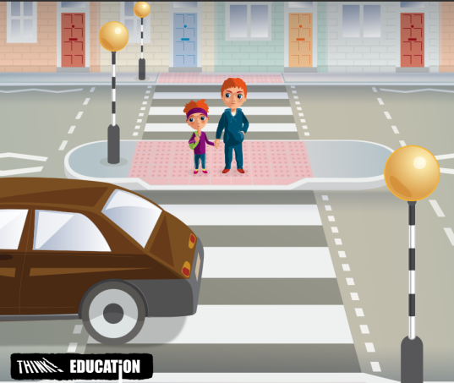
Always check the cars have stopped before you cross.

Slide 21
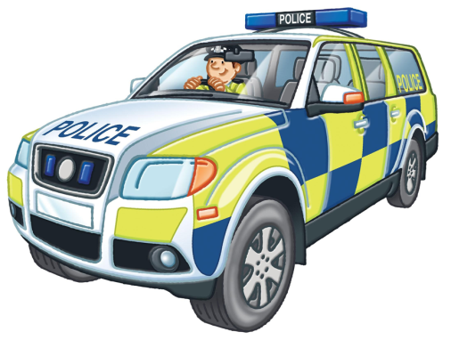
Sometimes the police officers will help direct traffic and help you cross.

Slide 22

If you have a “lollipop” person to help you cross, do as they ask.

Slide 23
If there is help….use it!

Slide 24
But what if there isn’t anything to help me cross the road safely?

Slide 25
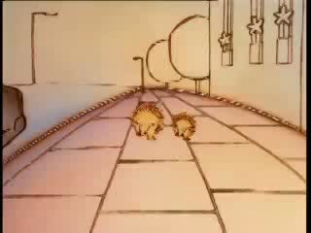
Where should I cross the road?
Click here
Notes:
You will need to press to play video (needs sound)

Slide 26
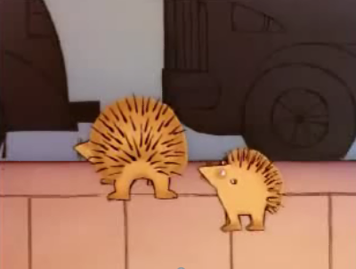
Not between parked cars. You can’t see if it is safe.

Slide 27
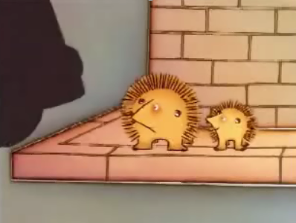
Not on a corner.
You can’t see if it is safe.

Slide 28
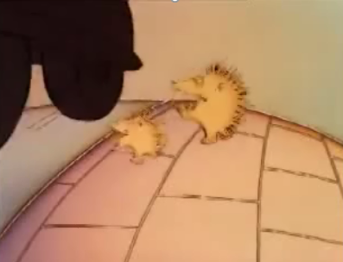
Not on the top of a hill.
You can’t see if it is safe.

Slide 29
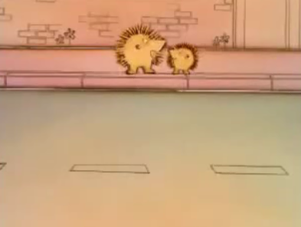
Straight road where you can see and you Stop, Look and Listen .

Slide 30

Click here
Notes:
You will need to press to play video, needs sound

Slide 31
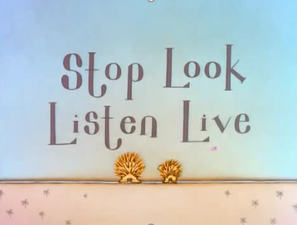
It doesn’t matter how old you are, it doesn’t matter who you are with, you must always….

Slide 32
Can you spot safe and unsafe places to cross the road?
Notes:
Activity - 10 mins

Slide 33
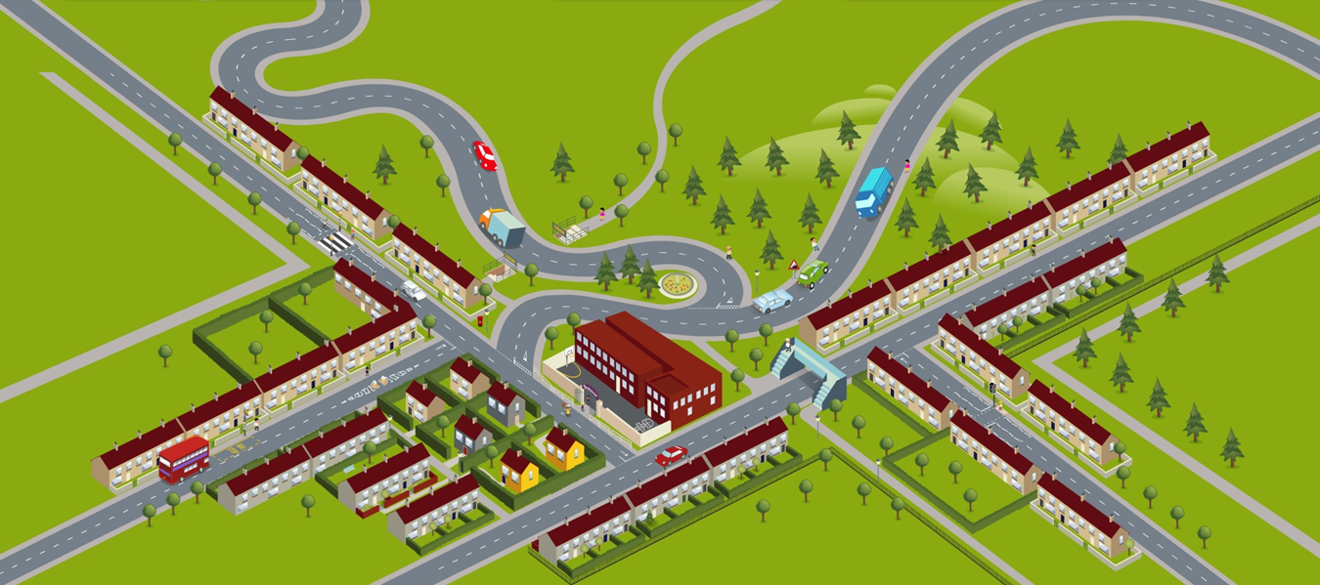
5 A subway is a good place to cross.
1 A zebra crossing is a good choice.
2 A traffic island is a good choice.
3 This is not a good place to cross. A bus is blocking your view of oncoming traffic.
4 A school crossing patrol will help you cross safety.
Notes:
Shows five examples

Slide 34
6 This is not a safe to cross near a sharp bend – you won’t see cars coming.
7 There are safer places to cross than this – the road is really busy.
8 Don’t cross near the brow of a hill – you won’t see cars coming from the other side of the hill.
11 A quiet, straight road with no parked cars is a good choice.
10 A pedestrian crossing is a good place to cross.
9 A footbridge is a good choice.
Notes:
Shows six examples

Slide 35
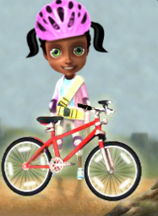
It is important to
know how to keep yourself
safe on the roads….
…when on a bike or scooter

Slide 36
Always wear your helmet to protect your head.
Make sure your bike is safe:
Lights working
Brakes working
Tyres pumped up

Slide 37


It is important to
know how to keep yourself
safe on the roads….
…all the time

