Slide 1
People & Organisational Development
Working Together – 13 September 2016

Slide 2
Organisational Development
A systematic approach to improving and enhancing organisational effectiveness…
…that aligns strategy, people and process…
…in a continuous review cycle (not a one off change intervention)
…that is led by Senior Leaders and Managers to ensure it covers all areas of the organisation…
.. and takes it forward in a planned, holistic way.

Slide 3
Future improvement
Service Transformation Programme
Our Communities
(IRMP)
Our People
(Culture)

Slide 4
Transitional Change
Shadow governance arrangements in place
Combination programme for 15/16, divided into 6 work-streams
Corporate Governance
Strategic & Organisational Development
Safety Centre, Strategic Hub/Headquarters
Service delivery & Operational Assets
People & Organisational design
ICT and information management
Old State
(Fire & Rescue Services)
x2 existed
April 15
New State
DWFRS
went live
April 16
Transitional State
New DWFRS Community Safety Plan 2016-20 developed & published including:-
Vision – ‘passionate about changing & saving lives’
Priorities
Making safer & healthier choices
Protecting you & the environment from harm
Being there when you need us
Making every penny count
Functional reviews informed the design & development of the new structure
Staff appointed to the new structure

Slide 5
Transformational Change
DWFRS
Transformation
journey
Successful & high achieving organisation
April 16
April 20
Good Great

Slide 6
Why now Transformational Change?
Continuing austerity measures across the Public Sector
Changing customer / stakeholder expectations
New performance challenges
New solutions needed, requiring innovation & creativity
Transformational change therefore needs to be organisation-wide
What do we need to do?
Develop a high performance & constructive culture
Take a learning organisation approach
Boost transformational capacity – “invest to save”
Encourage & maximise the cross fertilisation of ideas & talent
Identify priority cross cutting themes & pool resources to deliver
Share knowledge & skills across the sector & identify “best practice”

Slide 7
 | Transactional Change | Transformational Change
Leadership | is responsive | is Proactive
Focus | is on solving problems; delivering defined results | on setting stage for revelation; delivering innovations
Process | works within the existing organisational culture | to change the organisational culture by involving staff & implementing new ideas
Participation | is by pushing employees through reward and punishment | by pulling employees through motivation and empowerment
Motivates | followers by appealing to their own self-interest | by encouraging them to transcend their own interests for those of the team / Service
Commitment | is buy-in and sign-off | built on trust; invested in process

Slide 8
Features of a constructive culture
Staff fully engaged (highlighted within DWFRS new Employment Engagement Strategy)
Staff encouraged to work to their full potential
High levels of motivation, satisfaction, team-work, with a focus on service quality outcomes (not tasks)
Quality is valued over quantity
Creativity is valued over conformity
Co-operation is believed to lead to better results than competition (one service – one team)
Inspirational, authentic leadership exists
Employees feel empowered and trusted
Focus on continuous improvement and “can do”

Slide 9
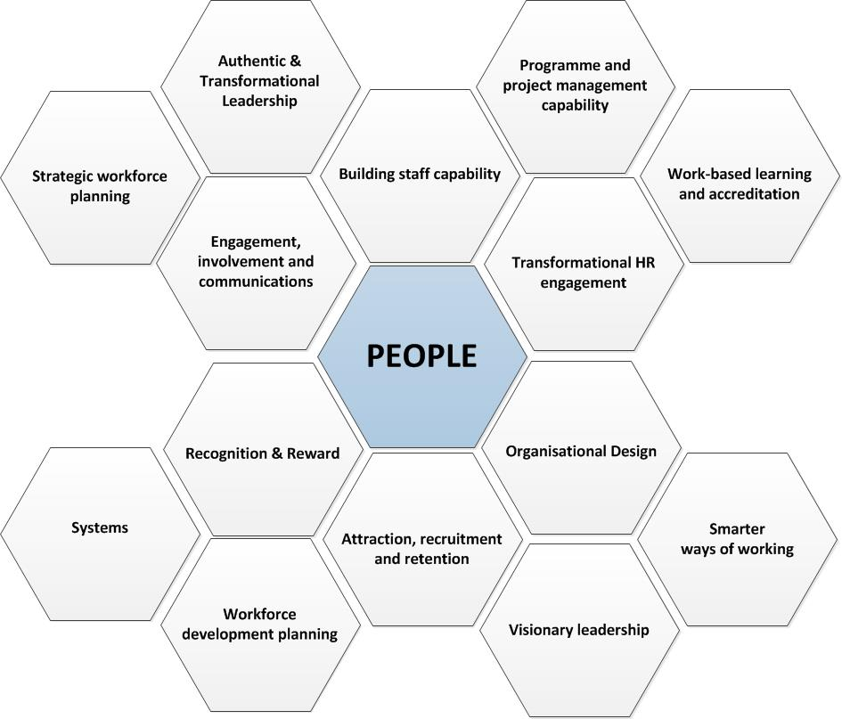

Slide 10
Strategic
Themes
x 7

Slide 11
Visible and ambitious leadership where people are empowered to bring about cultural and structural change to deliver the strategic priorities and which secures the necessary flexibility adaptability and resilience to cope with ever changing external environment
Transformational leadership approach
Bringing RESPECT life
Role, responsibilities and authority levels
Cultural ideal and levers for change
Leadership and management development

Slide 12
Clear workforce planning and talent management principles are used to deliver effective HR support and to align workforce planning with the strategic aims and objectives of the Service.
Workforce planning approach
Recruitment processes
HRBP model
HR metrics
Organisational design

Slide 13
A competent, confident workforce equipped with the right skills, knowledge and attitudes to achieve current and future Service objectives; fair access to development opportunities to enable people to reach their full potential; blended learning options enable self-directed learning and support the transfer of skills to the workplace.
Learning and development offering
Skills pathways
Competence recording
Education funding
Blended learning
Apprenticeships

Slide 14
Maximised capacity and capability through the efficient use of technology and a systems thinking methodology to enable an agile workforce to:
deliver innovative and collaborative ways of working within the Service and with key partners;
support continuous drive for performance improvement and flexibility
engage and communicate through a wide variety of media;
effectively use available resources.
ICT interventions
ICT system training
Guidance for staff and managers
Embedding and role-modelling of principles
Continuous improvement

Slide 15
A Performance Culture which is outcome-focused and a Service-wide Performance Framework that aligns people with the Service’s strategic objectives; developing the capability and talent of our people to deliver results
Performance appraisal
1-2-1 meetings
Manager skills training
QA process

Slide 16
What we mean by this:
A great environment to work in where people feel valued, respected, fairly rewarded and able to reach their full potential; enabling us to attract and retain the right people in the right places to deliver Service objectives.
Key Activities
Recognition and reward
Attraction and selection of staff
Partnership working
Employee health and wellbeing

Slide 17
An engaged Service that people are proud to work for; staff are committed to corporate objectives and feel able to input ideas and share knowledge for the benefit of colleagues and our communities.
Communication of strategies and plans
Staff surveys
Cultural review and audit
Engagement approach
Equality, Diversity and Inclusion

